Slide 1
Structure of multi-neutron system and future study
E. Hiyama(Tohoku Univ./RIKEN)
Rimantas Lazausukas(Strasbourg)
Jaume Carbonell(Orsay/CNRS)
Tobias Frederico(ITA)

Slide 2
Outline of my talk:
n
n
n
⁵H
n
n
p
t
⁷H
n
n
n

Slide 3
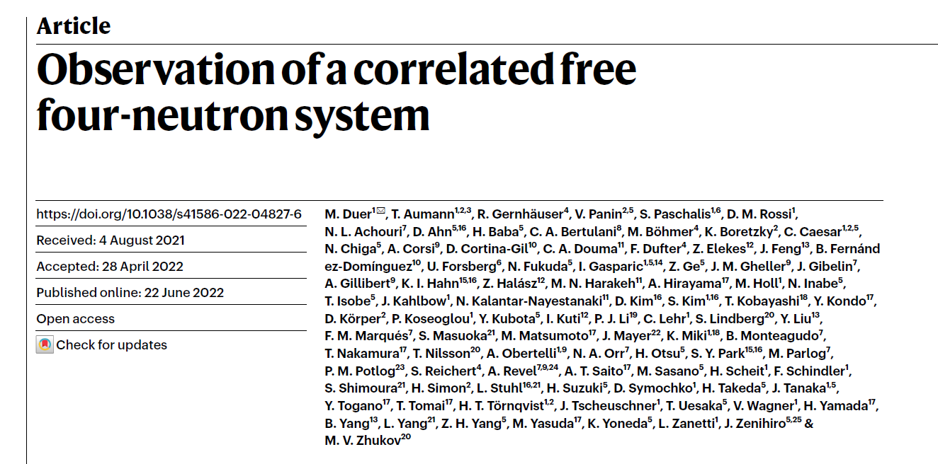
Tetra-neutron system is important to study T=3/2 three-nucleon
force.
n
n
n
n
The detail was reported
by Shimoura san.

Slide 4
Summary of the 4n calculation
Author
Method
How to obtain resonant state V_{NN} resonance
A.M. Shirokov et al. Non-core shell model + phase shift analysis JISP16 Er=0.8 MeV
Γ=1.4 MeV
S. Gandolfi et al. Quantum Monte Calro extrapolation chiral(NNLO) Er=1.84 MeV
Γ=0.282 MeV
K. Fossez et al., no-core Gamow shell model N3LO, JISP16, Er～7MeV
Γ～3.5MeV
E. Hiyama, R. Lazauskas et al., Gaussian Expansion + CSM AV8 No resonance
Faddeev Yakubovsky
Deltuva, Faddeev Yakbobsky + AGS SRG(AV18),NLO, No resonance
M. D. Higgins et al., Hypersherical harmonics phase shift analysis AV8, AV18, no resonance

Slide 5
To understand 4n system in more detail….
p
n
n
n
n
⁵H
n
n
n
p
n
Let’s add one triton to 4n.
⁷H
t
n
Neutron:6
Proton: 1
n
t
Super heavy hydrogen
n
n
n
n
Can we understand ⁵H and ⁷H with
NN interaction so far proposed?
n
n
⁷H is bound, resonance, nothing?

Slide 6
n
n
⁵H
transfer reaction p(⁶He, ²He)⁵H
n
p
n
A. Korcheninnikov, et al. Phys. Rev. Lett.
87 (2001) 092501.
Γ=1.9±0.4 MeV
Superheavy hydrogen
1/2⁺
1.7±0.3 MeV
t+n+n

Slide 7
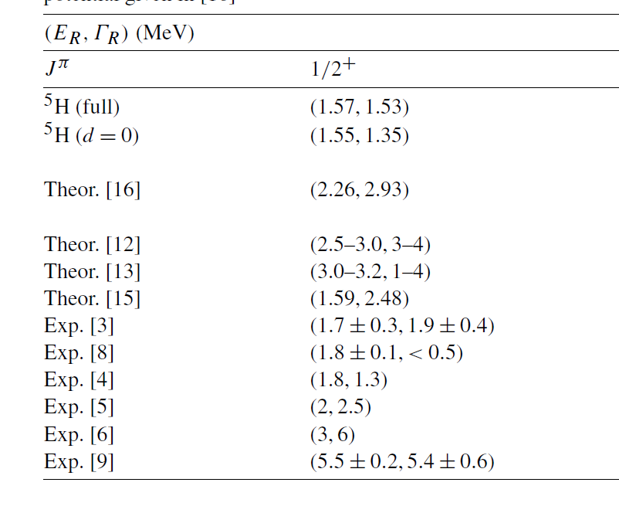
[3] A.A. Korosheninnikov et al., PRL87 (2001) 092501
[8] S.I. Sidorchuk et al., NPA719 (2003) 13
[4] M.S. Golovkov et al. PRC 72 (2005) 064612
[5] G. M. Ter-Akopian et al., Eur. Phys. J A25 (2005) 315.
Energy of 5H is similar. But decay width is dependent on experiment.

Slide 8
In 2017, we have a new data on ⁵H.
A. H. Wuosmaa, Phys. Rev. C95, 014310 (2017)
⁶He (d,³He) ⁵H
E_{r}=2.4±0.3 MeV Γ=5.3 ±0.4 MeV
⁷H
A. Korsheninnikov et al., PRL 90,
082501 (2003)
M. Caamano et al., PRL99, 062502(2007)
PRC 78, 044001 (2008)
n
n
n
n
n
p
n
E_{r}=0.57
+0.42
MeV
from t+4n threshold
-0.21
If we have narrow
decay at lower energy,
we could have
heavier H-hydrogen isotope
such as ⁹H.
Γ=0.09
+0.94
MeV
-0.06
¹²C(⁸He,⁷H)¹³N reaction
What is limit for H-isotope? Probably ⁷H?

Slide 9
Theoretical calculation for ⁵H and ⁷H
N. K. Timofeyuk, PRC65, 064306(2002), PRC69 , 034336(2004)
Volkov NN potential, Hyperspherical harmonics method: 5-body and 7-body
calculations
⁵H: about 1 MeV above t+n+n threshold.
⁷H: about 3MeV above t+4n threshold
She calculated the energies with bound state approximation.
Then, she did not give decay width for these nuclei.
S. Aoyama and N. Itagaki, PRC80,021304 (R)
Volkov NN potential, AMD calculation
⁷H: 4.2 MeV above t+4n threshold, no calculation for decay width
No report for the energy of ⁵H
H. H. Li et al., PRC 104, L061306 (2021)
Gamow shell model calculation using Minnesota NN potential.
Energy and decay width of ⁵H is 1.4 MeV and 0.5 MeV, respectively.
Energy and decay width of ⁷H is about 2-3MeV and about 0.1 MeV,
respectively.
They predicted to have very narrow decay width for ⁵H and ⁷H.

Slide 10
Experiment situation:
Recently, ⁸He (p,2p) ⁷H reaction has been done at RIBF.
RIBF Experimental Proposal NP1512-SAMURAI34.
The analysis is on going.
Then, it is timely to calculate ⁷H to obtain the energy and width
theoretically.
Motivated by this situation, we study ⁷H structure within the
framework of t+4n 5-body problem. We also discuss on the
energy and decay width of ⁵H within t+n+n three-body problem.

Slide 11
Framework
NN: Minnesota potential (central potential)
n
n
n
⁷H=t+4n model
n
t
t-n potential => there is a large degree of ambiguity.
Only several data for phase shift of t-n
⁵H
n
n
t

Slide 12
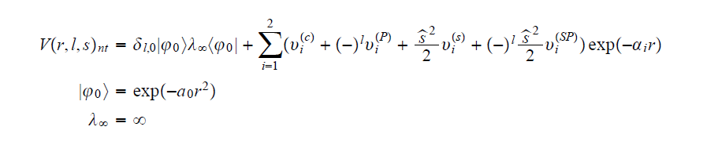
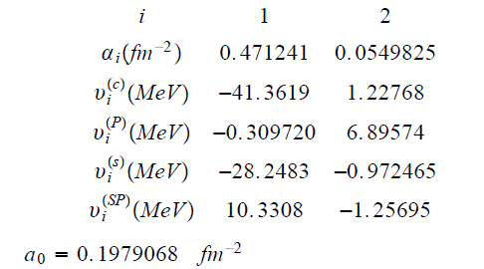
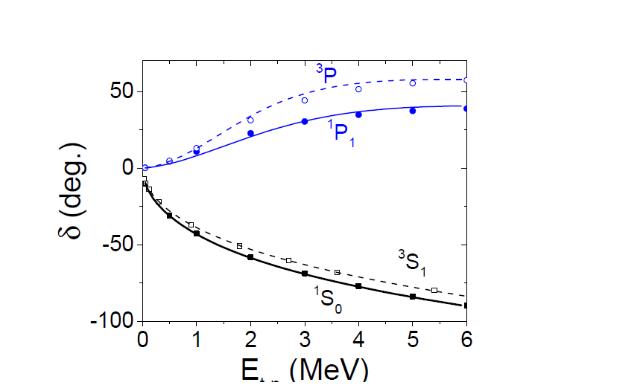
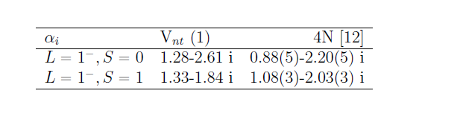
2
Based on four-body calculation with MT I-III
Two-body calculation of t-n is almost consistent
with that of 4-body calculation.

Slide 13


This is origin of breaking effect of ³H core.
+ I introduce a phenomenological
three-body t-n-n force to obtain energy trajectory.
V₀,b₃ : parameters.
Fit so as to reproduce the
data of ⁵H
apply
⁵H
n
n
t
Question: Which experimental data
of ⁵H should we fit?

Slide 14
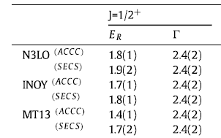
R. Lazauskas, E. Hiyama, J. Carbonell, PRB 791 335 (2019)
Fadeev-Yakubovsky method calculation of ⁵H
Γ=1.9±0.4 MeV
We take this result as ‘exp.’ data.
1/2⁺
Close to the below exp.data
1.7±0.3 MeV
A. Korcheninnikov, et al. Phys. Rev. Lett.
87 (2001) 092501.
t+n+n

Slide 15
Our few-body caluclational method
Gaussian Expansion Method (GEM) , since 1987
,
・A variational method using Gaussian basis functions
・Take all the sets of Jacobi coordinates
Developed by Kyushu Univ. Group,
Kamimura and his collaborators.
Review article :
E. Hiyama, M. Kamimura and Y. Kino,
Prog. Part. Nucl. Phys. 51 (2003), 223.
High-precision calculations of various 3- and 4-body systems:
Exotic atoms / molecules ,
3- and 4-nucleon systems,
multi-cluster structure of light nuclei,
Light hypernuclei,
3-quark systems,

Slide 16
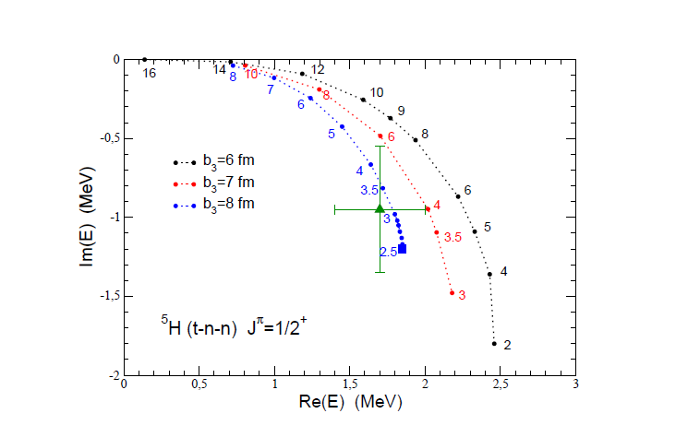
When b₃=8 fm and V₀=3 to 2.5 MeV, the energy pole of
⁵H is close to exp. data. If we have this potential parameter,
what is energy pole of ⁷H?

Slide 17
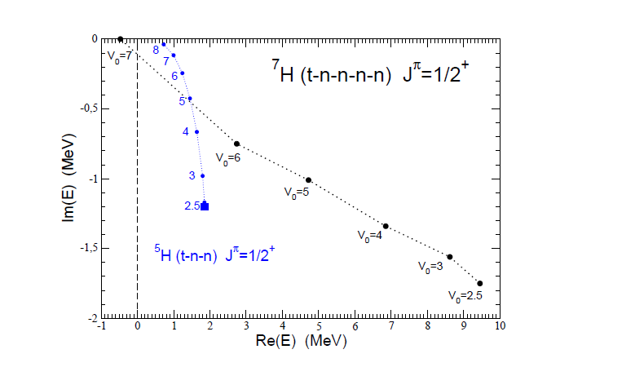
Im (E)=Γ/2
For V₀=2.5, we reproduce the data of ⁵H accurately.
In this case, the energy pole of ⁷H, E=9.5 MeV, Γ～3.5 MeV.
Our energy of ⁷H is much higher and broad decay width.

Slide 18
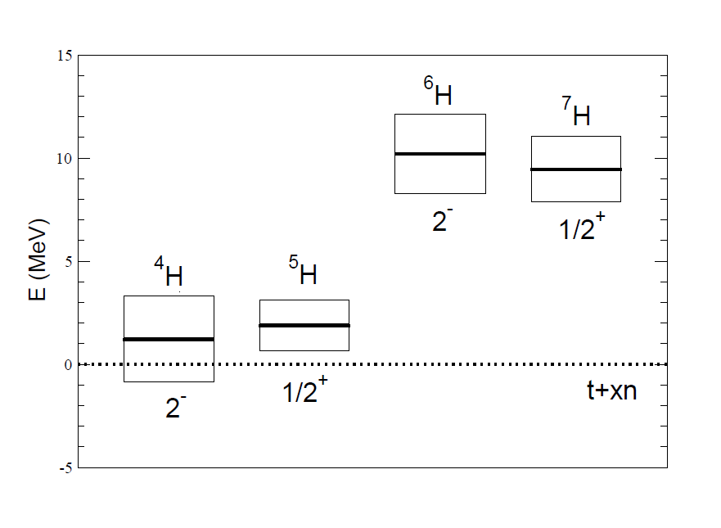
Summary of H-isotope (according to our calculation)
End of H-isotope
prediction
We are waiting for experimental data for ⁷H. Once the energy and decay width of ⁷H is determined, we can
also determine the energy and decay width of ⁵H.

Slide 19
Future work
Exploratory Research for Advanced Technology(ERATO) organized by Japan Science and Technology Agency
(JST)
Started from Oct. in 2023 to Mar. in 2029
I and Prof. E. Epelbaum are one of member in her project.
I will not talk this project in detail.

Slide 20
My mission in this project:
To achieve the goal:
Use Chiral EFT force and to develop our method up to 10-body systems:
Current situation: five-body calculation
Within five years: Fermionic system+χFT interaction
Future NN scattering data
Obtain information three-nucleon force
Especially, T=3/2 force
Just last week, our proposal to use ‘Fugaku’ supercomputer which is one of the most powerful supercomputer
in the world, has been approved and we start to use next October.

Slide 21
Thank you

