Slide 1
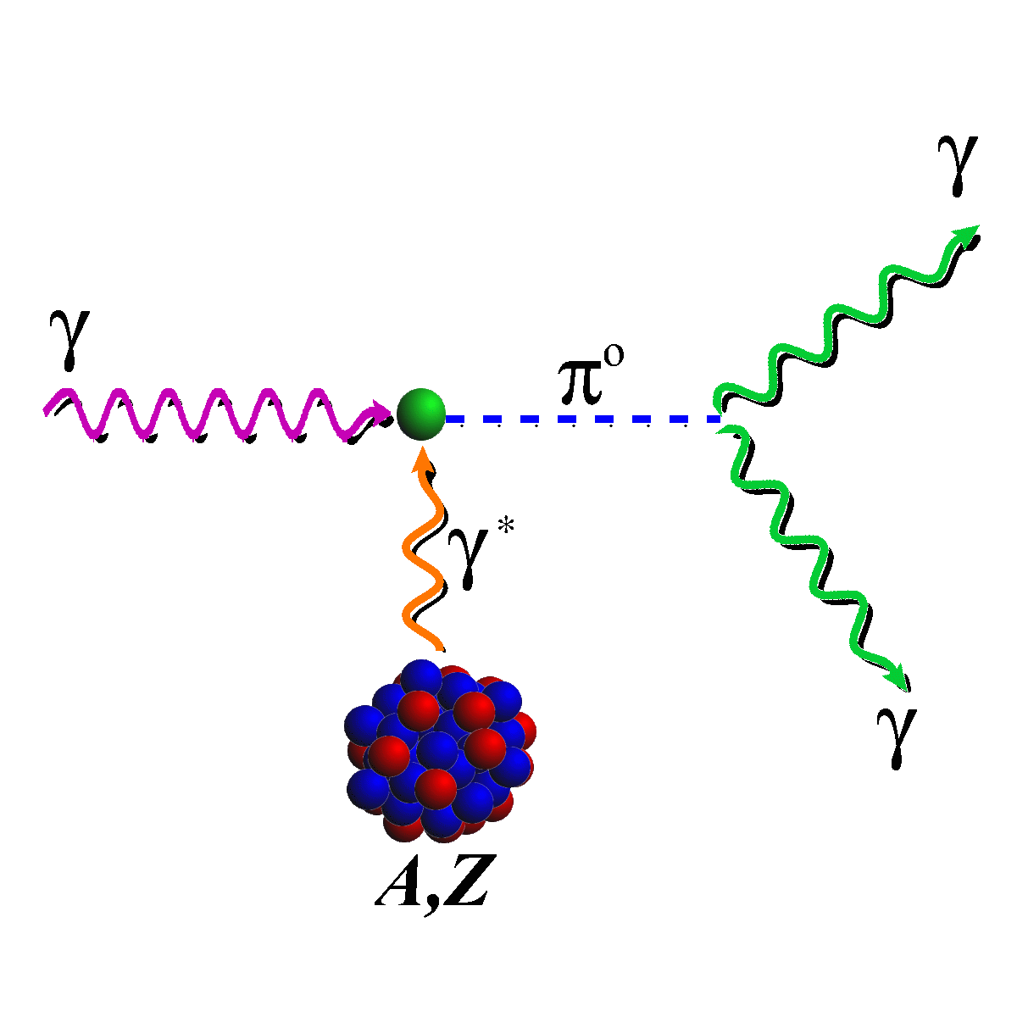

Status of the PrimEx -η Experiment at Jefferson Lab
Somov Jefferson Lab
on behalf of the PrimEx working group
The 11th International Workshop on Chiral Dynamics
Ruhr University Bochum, Germany
August 26-30, 2024

Slide 2
Outline
Physics motivation
Primakoff program at Jefferson Lab
GlueX detector in Hall D
Measurement of the radiative decay width of η using GlueX detector
Future plans

Slide 3
Symmetries in QCD and Light Pseudoscalar Mesons
γ
  π⁰→γγ , η→γγ, and η’→γγ decays
  are associated with the Chiral anomaly
π, η, η′
γ
  Decay widths can be computed precisely in
  higher orders
  SU(3) and isospin breaking by the unequal quark masses induce mixing among π⁰, η, and η’
π⁰, η, η’ mesons provides a rich laboratory to study the symmetry
structure of QCD

Slide 4
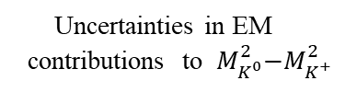

Decay Width of η Mesons : Physics Motivation
Light quark mass ratio:
      η→3π forbidden by isospin symmetry:
Γ(η→3π) ~ |A|² ~ Q⁻⁴
Γ(η→3π)=Γ(η→γγ) ⋅ BR(3π) / BR(γγ)
Phys. Rept. 945 (2022) 1-105
Theoretical calculations:
$Q^{2}\sim \frac{M_{K}^{2}}{M_{π}^{2}}$ $\frac{M_{K}^{2}−M_{π}^{2}}{ {(M_{K^{0}}^{2}−M_{K^{+}}^{2})}_{QCD}}$
Uncertainties in EM
contributions to ${ M}_{K^{0}}^{2}−M_{K^{+}}^{2}$

Slide 5
Physics Motivation
(η - η′) mixing angle
L. Goity and al. PRD 66 (2002) 076014
SU(3) symmetry breaking induces mixing
between the SU(3) states
Cornell
Primakoff
(η - η′) mixing angle (deg)
The mixing angle θ can be determined using
measured decay widths Γ(η^{(′)} → γγ ) and NLO
corrections to decay constant
PDG
Average
Important to analyze together decays
η^{(′)} → γγ and η → γγ
GlueX
  Significantly improve all η
  decay widths in PDG
Collider
Average
Experiments
Γ(η→X) = Γ(η→γγ) ⋅ BR(X) / BR(γγ)

Slide 6
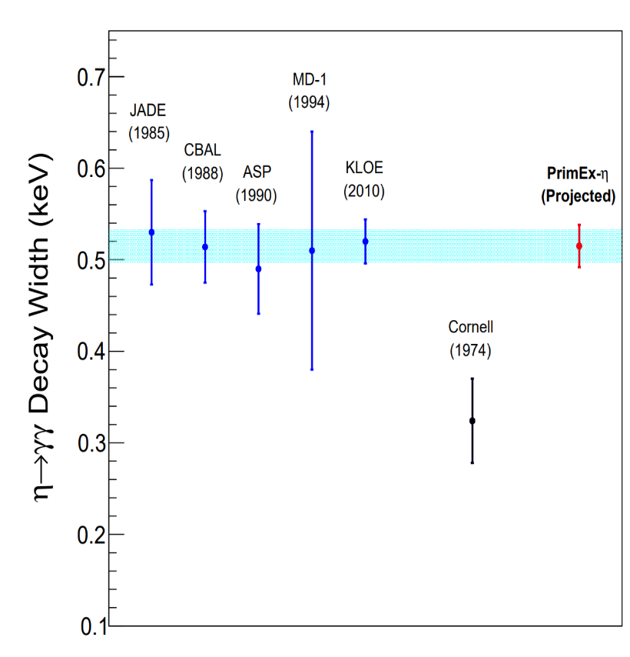
Measurements of Γ(η→γγ)
The partial width Γ(η→γγ) was
derived from measurements
- collider experiments in the reaction
e⁺ e⁻ → e⁺ e⁻ η
- Primakoff production of η mesons
Some disagreements between collider
and Primakoff results
New measurement of the decay width using Primakoff process PrimEx - η
experiment at Jefferson Lab
Initial goal for uncertainties 3.2 %, more likely be 6 – 9 %

Slide 7
The Primakoff Method
η
ρ,ω
Cross Section dσ / d Ω (mb/srad)
sin²θ_{η}
η production angle θ_{η} (deg)
η
Measure differential cross section dσ/dΩ
Contributions from:
- signal Coulomb
- nuclear coherent (incoherent)
- interference between signal and coherent
- other hadronic background
Distribution shapes are computed
or measured
Free parameters in the fit:
- normalizations, interference
phase

Slide 8
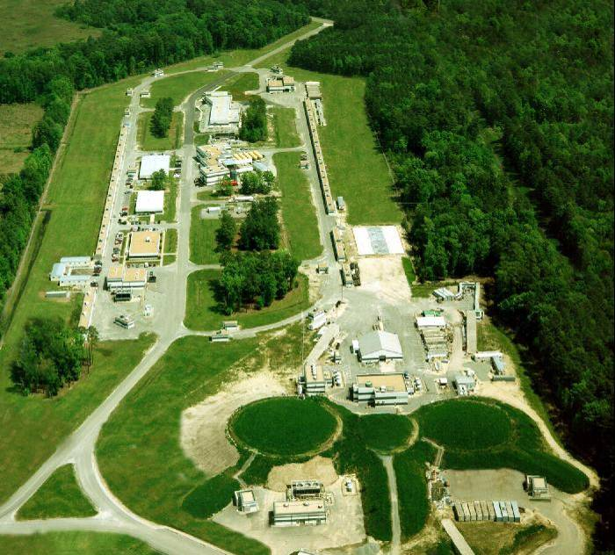
Jefferson Lab
Hall D
A
B
C
CEBAF energy upgrade from 6 GeV to 12 GeV
Four experimental halls: A, B, C, and D
Hall D constructed in 2016
- beam of linearly polarized photons
Notes:
help me

Slide 9
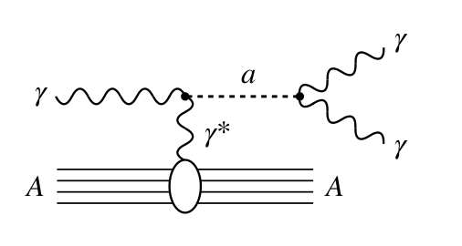

Pimakoff Program at Jefferson Lab
I) Determination of two photon decay widths:
Γ(π⁰ → γγ) PrimEx I, II experiment in Hall B at 6 GeV
Γ(η → γγ) PrimeEx-η experiment in Hall D at 12 GeV
Γ(η′ → γγ)
- test Chiral symmetry and anomaly, extract light quark mass ratio, determine
η - η′ mixing angle
II) Measuring the charged and neutral pion polarizability
Primakoff production of π⁺ π⁻ and π⁰ π⁰
(see talk by R. Miskimen)
Hall D, polarized photon beam (collected data in 2022)
III) Search for axion-like particles through nuclear Primakoff production
APL predominantly couple to photons, with an
effective ALP-photon interaction
portal to probe beyond-SM physics (dark sector)
Search for ALP in Hall D
Phys.Lett.B 855 (2024) 138790

Slide 10
Pimakoff Program at Jefferson Lab
(see talk by L. Gan)
IV) Measure transition form factors at low Q² (0.001 – 0.5 GeV² /c²)
with an electron beam
F(γγ*→ π⁰), F(γγ* →η), F(γγ* →η′)
new experiment in Hall B (in preparation)
π⁰ electromagnetic transition radius, input for
hadronic calculations in muon (g-2)
V) Extension of the Primakoff program for the Jefferson’s Lab
energy upgrade to 22 GeV
Primakoff production off π⁰ of an electron (detect recoil electron)
Improve measurements of η / η′

Slide 11
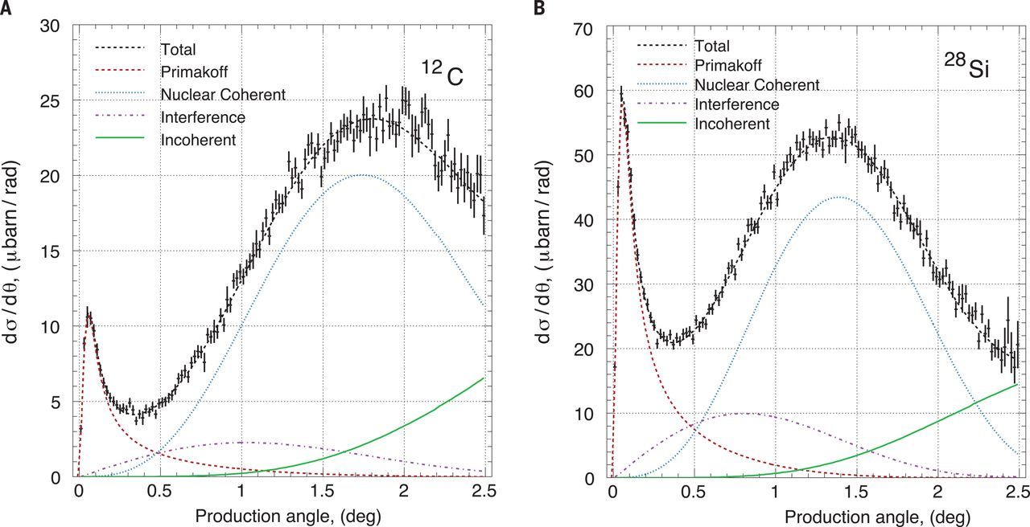
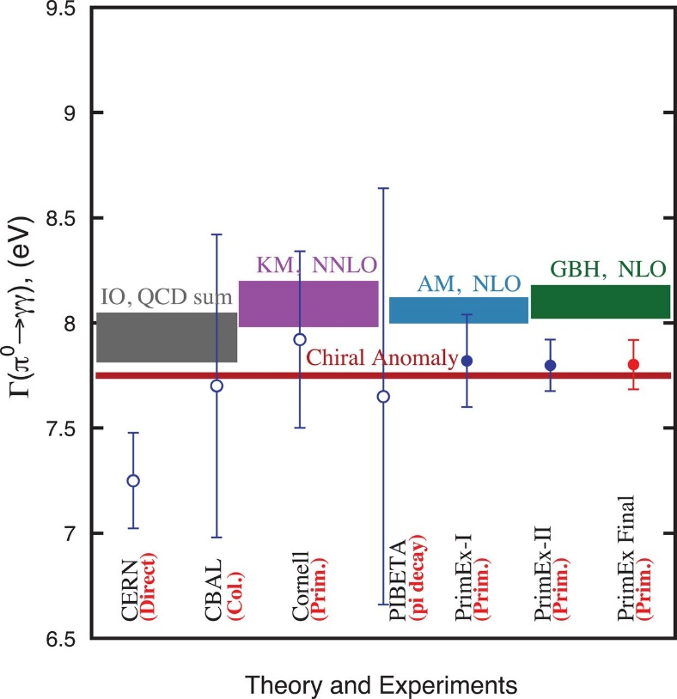
Measurement of π⁰ Decay Width
Science 368 (2020) 6490, 506-509
Two experiments in Hall B
in 2004 and 2010 using 6 GeV
tagged photon beam
Phys.Rev.Lett. 106 (2011) 162303
Nuclear targets:
¹²C, ²⁰⁸Pb, and ²⁸Si
Science 368, 506-509 (2020)
The chiral anomaly can be exactly calculated for
massless quarks
Combined measurements from two PrimEx runs
Γ(π⁰→γγ) = 7.802 ± 0.052(stat.) ± 0.105(syst.) eV
The decay width was measured with the total
uncertainty of 1.5 %

Slide 12
Measurement of η → γ γ Decay Width
Challenges of the measurement
Small cross section, increases with the energy σ_{prim} ∼ log(E)
η mass is a factor of 4 larger than π⁰
- larger momentum transfer (nuclear excitations, control coherency)
Large overlap between Primakoff and hadronic processes
use a low-A target ( LHe₄ )
  measurement at high beam energy, E_{γ} > 8 GeV
General requirements to the experiment:
Good angular resolution for reconstructed η mesons
Precise measurements of luminosity

Slide 13
GlueX Detector in Hall D at Jefferson Lab
Photons: σ_{E} / E ~ 6 % /√E ⊕ 2.0 %
Nucl. Instrum. Meth. A 987, 164807 (2021)
Tracks: σ_{p} / p ~ 2 – 5 %
Acceptance: 1 ° < θ < 120°
Experiments:
Search for mesons with
exotic quantum numbers
Study of meson and baryon
decays to strange final states
Measurement of η radiative decay width via the Primakoff effect
Measurement of pion polarizability
Study short range correlations
Study η^{(′)} decays (JEF)
Measurement of high energy contribution to the GDH sun rule
Strange hadron spectroscopy with KL beam
Beam of tagged photons with the energy of up to 12 GeV, linear polarization
(produced by CEBAF electrons via the bremsstrahlung process)
The detector design is optimized to detect multi-particle final states
The detector was commissioned in 2016. Several experiments have been carried out since then

Slide 14
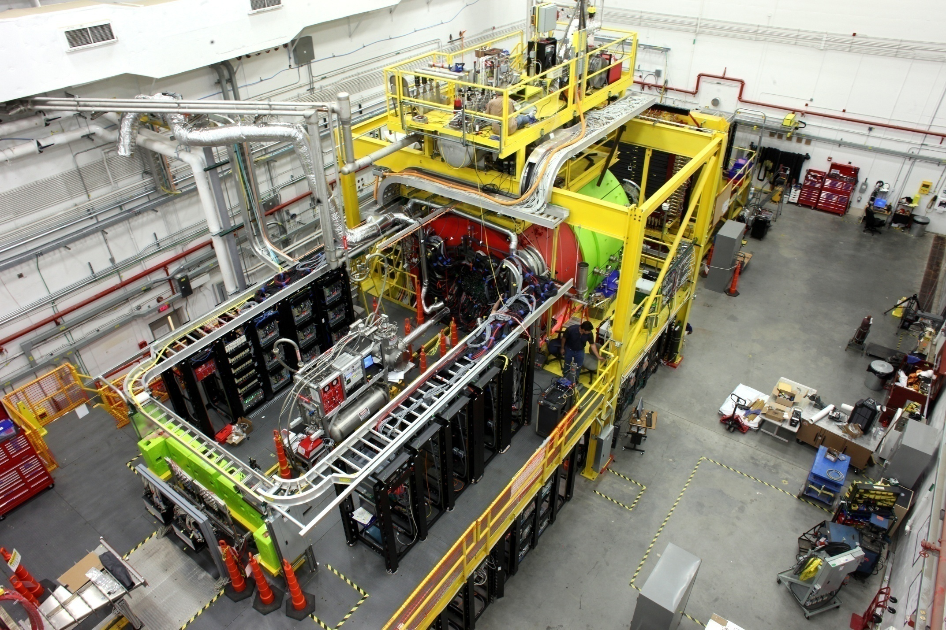
GlueX Detector

Slide 15
PrimEx – η Experiment in Hall D
Compton
calorimeter
Use Compton scattering reaction for:
- absolute luminosity normalization
(Be target)
- stability monitoring
(⁴He target)
New liquid ⁴He and Be targets
New Compton Calorimeter
Reconstruct η mesons using decays:
η→γγ (η→3π)

Slide 16
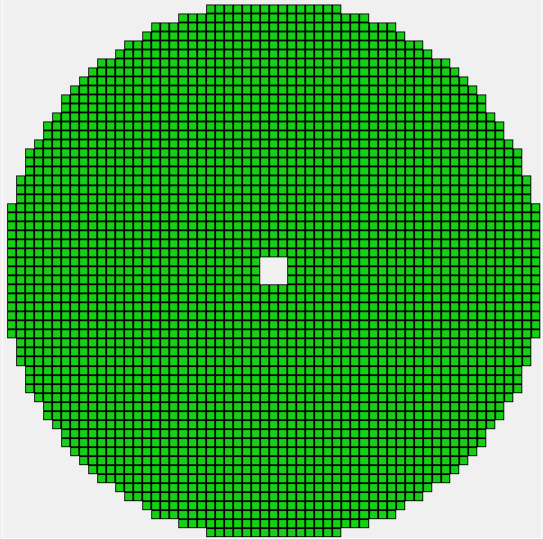

PrimEx – η Experiment
Three sets of data collected at different beam energies
 | Phase I | Phase II | Phase III
Year | 2019 | 2021 | 2022
E_{beam} | 11.2 | 10.0 | 11.6
Luminosity | 6 pb⁻¹ | 2 pb⁻¹ | ∼ 15 pb⁻¹
Magnetic field | OFF | OFF (most runs) | ON
∼ 5 months of
data taking in total
η→ γγ decays are reconstructed in the forward calorimeter
2800 lead glass modules (taken from E852 experiment at BNL)
- lead glass block size: 4 cm x 4 cm x 45 cm
The energy resolution:
Acceptance: 0.6° < θ < 11°
Beam hole in the middle of the detector: 12 cm x 12 cm
- place Compton calorimeter downstream the beam to
improve coverage in the forward direction
Forward Calorimeter
$\frac{σ \left(E\right)}{E}\left(\%\right)= \frac{6.2 }{\sqrt{E}} $ 4.7
beam hole

Slide 17
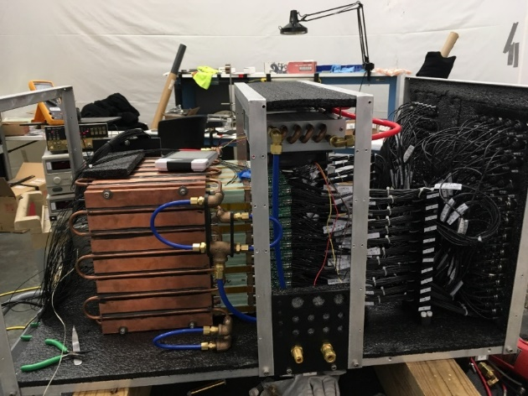
Compton Calorimeter
Allows to reconstruct forward-directed Compton scattering
events
Covers a beam hole in the GlueX forward lead glass
calorimeter
- increase angular acceptance of the detector
to θ_{MIN} > 0.1
Consists of an array of 12 x 12 modules of PbWO₄
scintillating crystals, 2 cm x 2 cm x 20 cm with a
beam hole of 2 x 2 modules
Positioned on a movable platform
- each module was inserted into the photon beam for
energy calibration
Integrated into the GlueX trigger. Reconstruct Compton
scattering events during GlueX production
- monitor density of the liquid ⁴He target and overall
detector stability
Nucl. Inst. Meth. A 1013 (2021) 165683
Cooling Plates
PMT housing

Slide 18
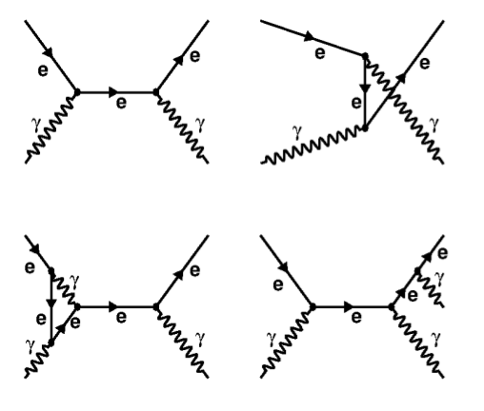
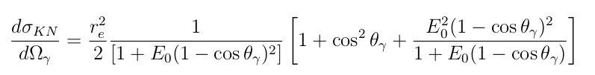
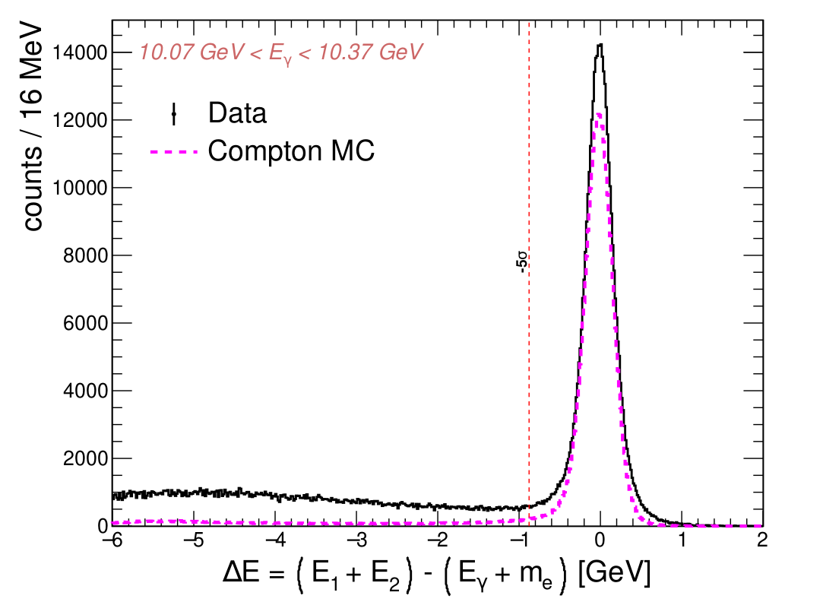
Compton Scattering
A. Smith
leading order (top)
Differential cross section at leading order
(Klein-Nishina)
Two-body kinematics
Main background from e± pairs

Slide 19

Compton Cross Section
A. Smith
First cross section measurement in the range between 6 GeV and 11.5 GeV
- previously measured for beam energies 4.4-5.3 GeV
Journal paper under preparation
Measurement are dominated by systematic uncertainties (3.6 %)
“Good” agreement with NLO calculations Phys.Rev.Lett. 126 (2021) 21, 211801
Phys.Lett.B 797 (2019)
Cross section measured on Be target (preliminary)

Slide 20
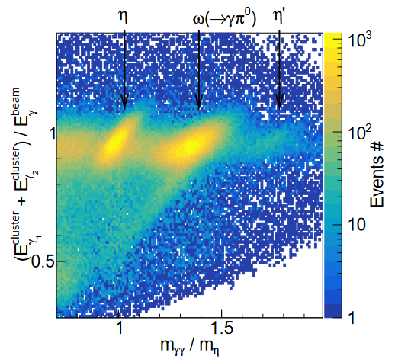
Status of the η → γγ Analysis
A. Smith & I. Jaegle
Event selection:
Two photons in the forward calorimeter originating from the same beam bunch
Use time-of-flight detector to veto charged tracks
Use barrel calorimeter to veto on hadronic background
Elasticity requirement, E¹_{γ} + E²_{γ} - E_{BEAM} < 1 GeV
Clear selection of η candidates
(large background)

Slide 21
Status of the η → γγ Analysis
Beamline background from electromagnetic pair production downstream the target
- peaking at small angles
- collected large empty-target data sample to subtract
Bin in the production angle, determine yield of η candidates for each bin from the
lineshape distribution

Slide 22
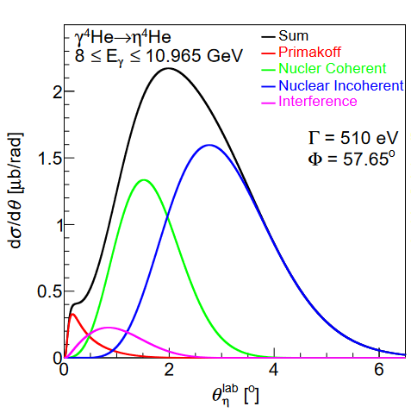

Angular Yield of η → γγ
A. Smith & I. Jaegle
Analysis of PrimEx Phase I data
L ∼ 6 pb⁻¹ (about 25% of the full data set)
Angular resolution of η → γγ decays is about 1 mrad
Efficiency corrected yield
Theoretical predictions (S. Gevorkyan)
arbitrary units

Slide 23
Future Plans

Slide 24
Extension of the Primakoff Program with the GlueX Detector
Upgrade of the GlueX forward calorimeter
Optimization of the detector beam line for Primakoff measurements
Study feasibility of using heavier nuclear targets. Measurement of the
decay width of η′
Prospects of Primakoff measurements after Jefferson Lab energy
upgrade to 22 GeV

Slide 25
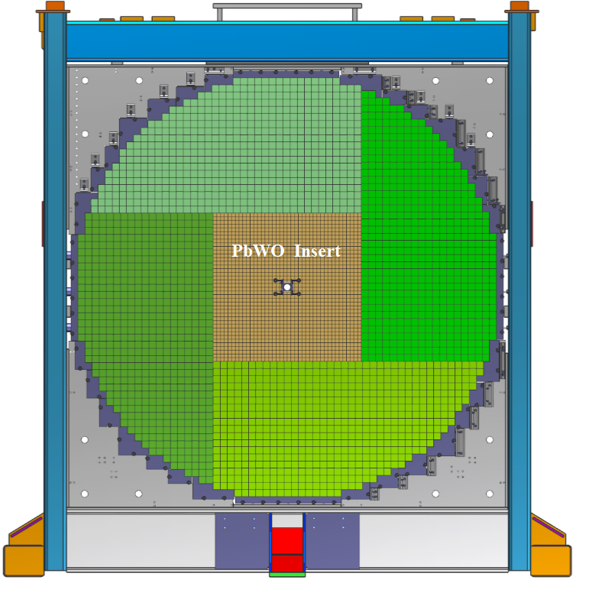
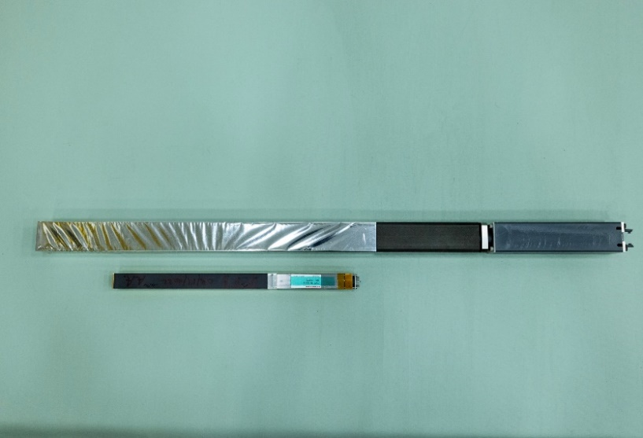
Lead Tungstate Eta Calorimeter (ECAL)
Upgrade the GlueX forward lead glass calorimeter with high-granularity
high-resolution lead tungstate scintillating crystals
Required by Jefferson Lab Eta Factory Experiment (see talk by L. Gan)
Significantly improve reconstruction of photons in the forward direction
ECAL consists of an array of 40 x 40 PbWO₄ (1596) modules
- 2 cm x 2 cm x 20 cm PbWO₄ crystal
- 4 cm x 4 cm x 45 cm lead glass block
Lead Glass & PbWO₄ modules
A factor of 4 better detector granularity
- significantly improve shower separation
Improves the energy and position resolutions by about a
factor of 2

Slide 26
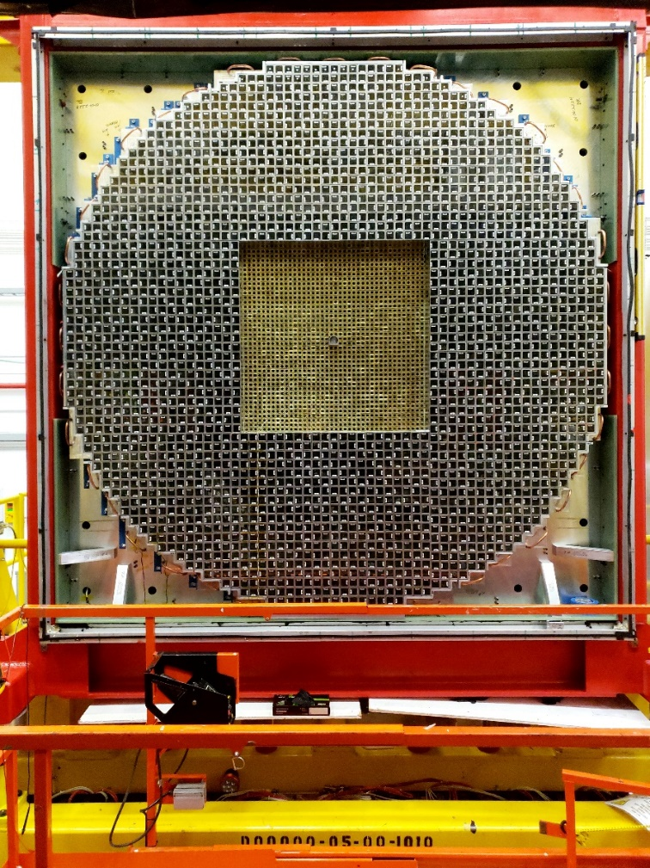
Installation of the ECAL
October 6, 2023
Started construction of ECAL PbWO₄ modules
in 2022
Detector installation completed in October
2023
ECAL is currently under commissioning.
GlueX run with the ECAL is scheduled for
January 2025

Slide 27
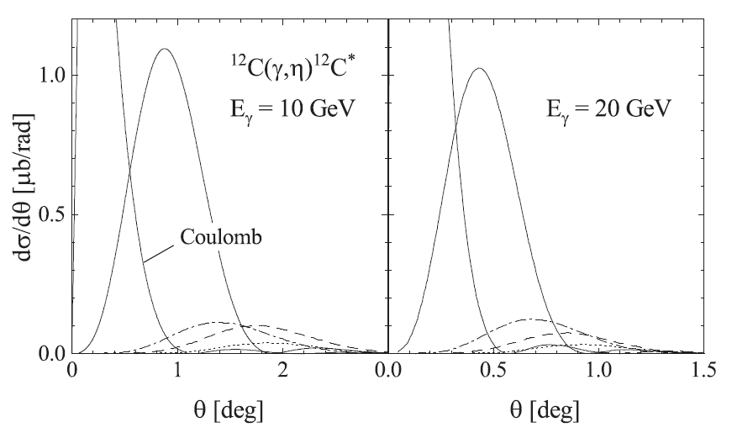
Feasibility of Using Heavy Targets for Measurement of
η → γ γ Decay Width
Primakoff cross section ∼ Z². Relatively large momentum transfer, have to consider
nuclear excitations (coherency of the reaction)
Calculations by A. Fix for coherent and incoherent photoproduction of
γ + ¹²C → η + ¹²C*
with various excitation levels
Phys. Rev. C 108, 044607 (2023)
Primakoff
coherent
excitations

Slide 28
Primakoff Program at 22 GeV
Primakoff cross sections increases with energy
σ(E = 20 GeV) / σ(E = 10 GeV) ~ 1.5
Better separation of Primakoff from hadronic processes:
Better energy, mass, and angular resolution of reconstructed η mesons
at large energies
Smaller momentum transfer ( t ) at larger energies q_{L} ~ (m² / 2 E),
q_{T} ~ 4 E E_{η} sin² (θ /2)
consider to use heavier targets (feedback from theorist)
smaller contribution from hadronic background

Slide 29
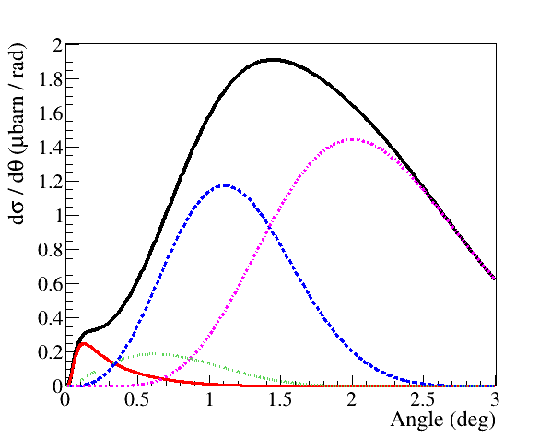
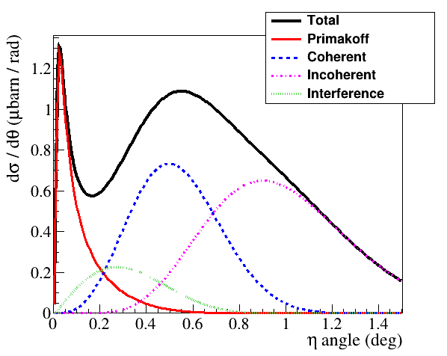
Primakoff η Production at 10 GeV and 20 GeV
Differential cross sections
He4 target
10 GeV
20 GeV
Primakoff
Significantly larger Primakoff peak at 20 GeV
- larger Primakoff cross section and better separation of the signal and
backgrounds
Simulation performed in the framework provided by S. Gevorgyan

Slide 30
Measurements of η′ → γγ Decay Width
η′ width was measured in several collider experiments using reaction
e⁺ e⁻ → e⁺ e⁻ η′
no background associated with a nuclear target
relatively large uncertainties on luminosity
Γ (γ γ) | Exp | Mode
4.17 ± 0.1 ± 0.27 | L3 | π⁺π⁻γ
4.53 ± 0.29 ± 0.27 | CBAL | ηπ⁰ π⁰
3.61 ± 0.13 ± 0.48 | CELL | ρ⁰γ, ηπ⁺ π⁻
4.6 ± 1.1 ± 0.6 | MD1 | π⁺π⁻γ
4.57 ± 0.25 ± 0.44 | MRK2 | ρ⁰γ, ηπ⁺ π⁻
5.08 ± 0.24 ± 0.71 | ASP | γγ
3.8 ± 0.7 ± 0.6 | TPC | ηπ⁺ π⁻
1.00 ± 0.08 ± 0.10 | CBAL | γγ
No Primakoff measurement of the η′ →γγ decay width has been
performed so far

Slide 31
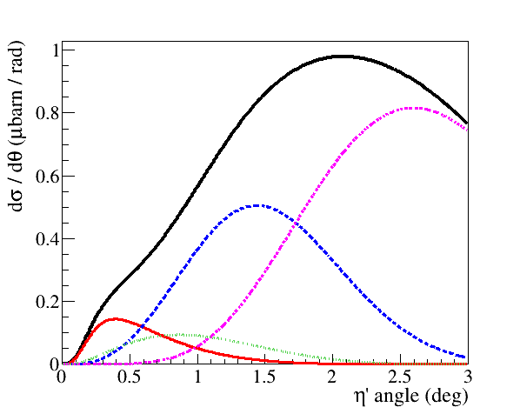
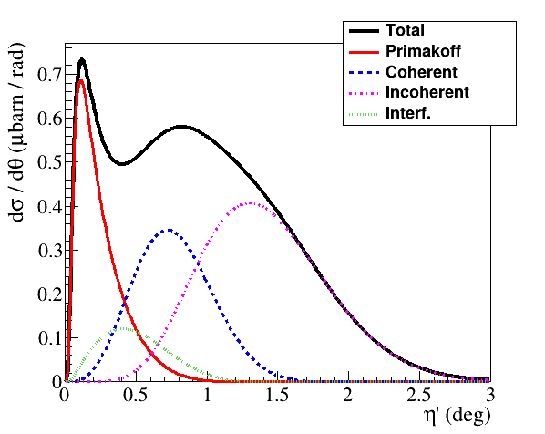
Primakoff η′ Production at 10 GeV and 20 GeV
He4 target
10 GeV
20 GeV
Primakoff
Difficult to extract Primakoff η′ signal on He target at 10 GeV
More ‘prominent’ Primakoff peak at 20 GeV
Currently study feasibility to use ¹²C target
- Primakoff cross section ~ Z²
- have to consider nuclear excitations

Slide 32
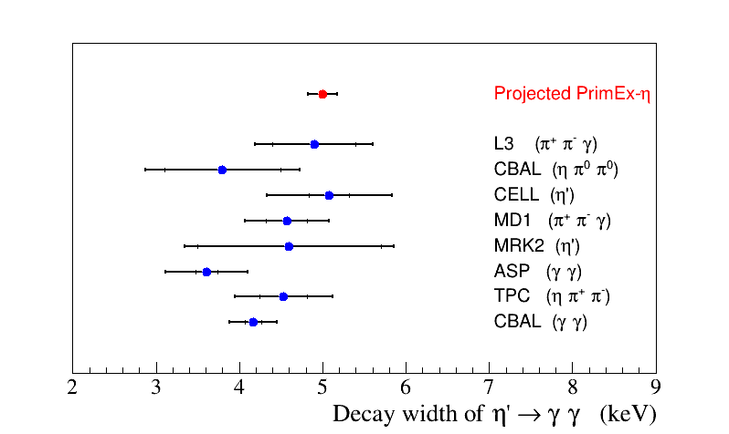
Expected Uncertainties on the η′ →γ γ Decay Width
Run conditions: photon flux in the beam energy range 19 –21 GeV: 2x10⁷ γ / sec, 6 % R.L. C target
Stat error on the Primakoff yield for η′ → ππη (γ γ) is about 3.5% for
20 days of data taking

Slide 33
Summary
Measurement of the radiative decay width of η mesons with the GlueX detector
is a part of the Primakoff program at Jefferson Lab, which was initiated by the
measurement of the decay width of π⁰ meson in 2004
The PrimEx-η experiment in Hall D completed collecting experimental data on a
liquid ⁴He target in 2022
  Calibration of the acquired data set and data analyses are currently ongoing
  The first publication of the Compton scattering cross section is under
  collaboration review.
We are studying the feasibility of extending the Primakoff measurements of the η
decay width using heavier targets and performing the first measurements of the η' decay
width. The current upgrade of the GlueX forward calorimeter will significantly improve
the photon detection capabilities.
The Primakoff physics program can be naturally extended to future experiments
after a possible Jefferson Lab beam energy upgrade to 22 GeV.

Slide 34
Backup Slides

Slide 35
Angular Yield of η → π⁰π⁰π⁰
A. Smith & I. Jaegle
Analysis of PrimEx Phase I data
L ∼ 6 pb⁻¹ (about 25% of the full data set)
η → γγ
arbitrary units
arbitrary units
Analysis of η → π⁺π ⁻π⁰ channel is ongoing
- most runs with the magnetic field in the PrimEx 3 phase, the trigger was also adjusted

Slide 36
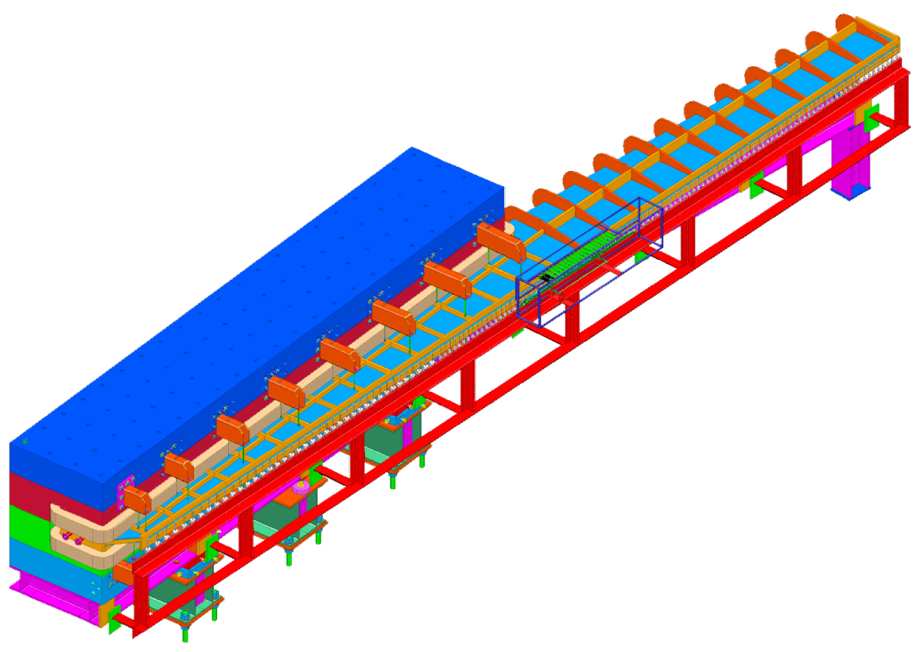
Tagged Photon Beam
Measure energy of each beam photon by detecting a bremsstrahlung electron
PrimEx D run conditions:
Photons to Hall D
Beam energy range: 9.5 – 11.7 GeV
Energy resolution: Δ E_{γ} / E _{γ} < 10⁻³
Photon flux: 7 ⋅ 10⁶ γ / sec
Electrons to the
beam dump
Fixed Array Hodoscope
12 GeV
e beam
233 scintillator counters
cover large energy range
3 GeV < E _{γ} < 11.7 GeV
accidental BG for PrimEx D < 4 %
Radiator

Slide 37
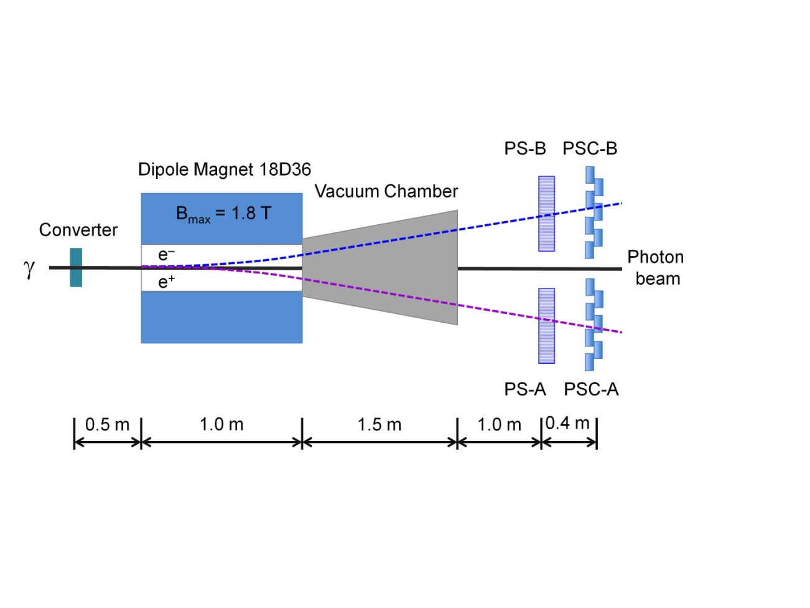
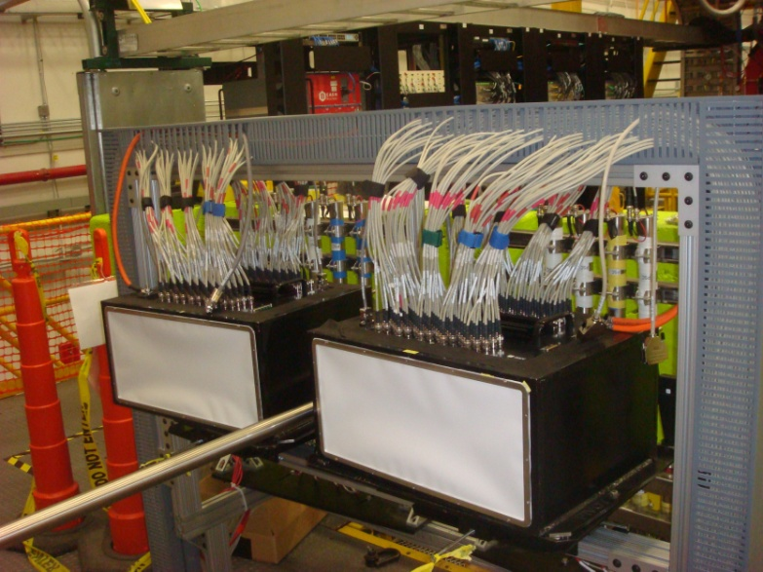
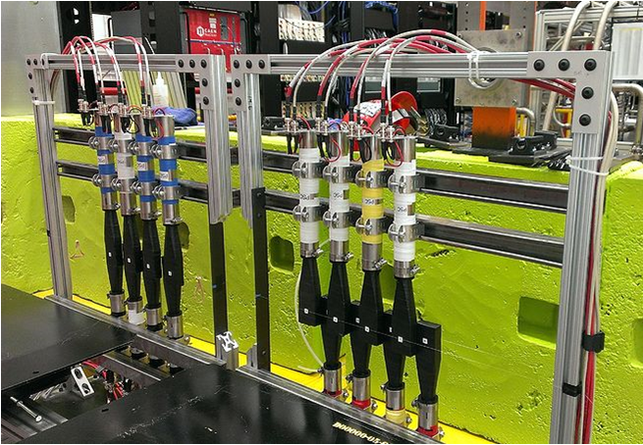
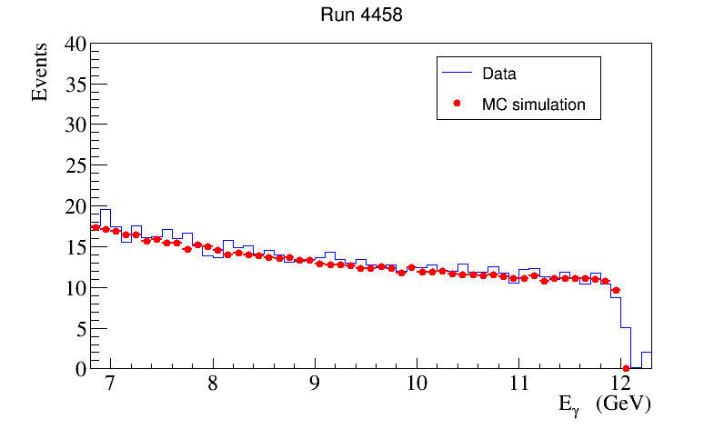
Photon Flux Measurements with Pair Spectrometer
Two layers of scintillator detectors:
Reconstruct the energy of a beam photon by
detecting e± pairs ( 6 < E _{γ}< 12 GeV)
Amorphous Radiator
PrimeEx D
Monitor the photon flux with the precision < 1 %

Slide 38
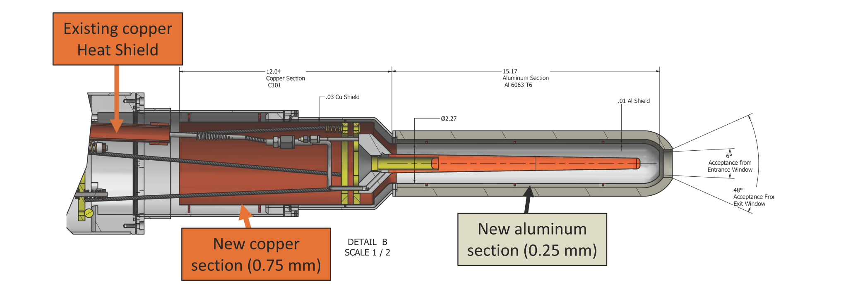
PrimeEx D Targets
liquid H₂ target (3.6 % R.L.): standard GlueX target
liquid He target (4.0 % R.L.): modify GlueX target
add heat shield around the target cell
Be target: Luminosity calibration using Compton process

Slide 39
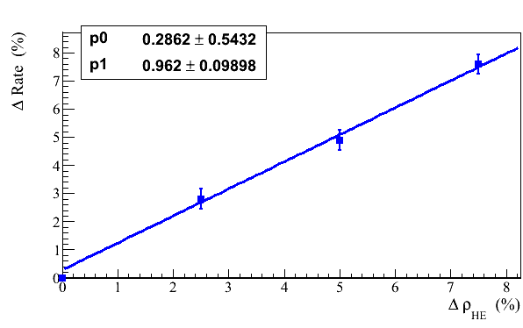
Target Density Monitor
Short term stability control:
- photon beam flux provided by the PS
- rates in the Start Counter (ST) and Time-of-Fight (TOF) wall
ST rate dependence on the target density
ST consists of 30 paddles surrounding the target
ST rate for production runs: 250 kHz / paddle
Coincidence of hits between the ST and TOF
(2 x 2 bars in TOF at R = 30 cm & one ST paddle)
1.5 kHz
Long term stability control:
- monitor using Compton process; expected rate in the photon range of
interest is about 30 Hz

