Slide 1
Light Pseudoscalar Mesons Decays at JLab
Liping Gan
University of North Carolina Wilmington
Outline
Introduction of Physics
PrimEx Primakoff Program
JLab Eta Factory (JEF) at GlueX
Summary
Thanks for support by NSF PHY-1812396 and PHY-2111181.

Slide 2
Open Questions in Modern Physics
What is the origin of QCD confinement?
How did the visible mass emerge in the early universe?
What is the cause of the matter-antimatter asymmetry in the universe?
What is the nature of dark matter?
Light pseudoscalar mesons offer a sensitive tool to explore these fundamental questions.

Slide 3
Low-Energy QCD Symmetries and Light Mesons
QCD Lagrangian in Chiral limit (m_{q}→0) is invariant under:
Chiral symmetry SU_{L}(3)xSU_{R}(3) spontaneously breaks to SU(3)
  8 Goldstone Bosons (GB)
U_{A}(1) is explicitly broken:
(Chiral anomalies)
  Non-zero mass of η₀
  Γ(π⁰→γγ), Γ(η→γγ), Γ(η′→γγ)
SU_{L}(3)xSU_{R}(3) and SU(3) are explicitly broken:
  GB are massive
  Mixing of π⁰, η, η′
  The π⁰, η, η′ system provides a rich laboratory to study the symmetry structure of low-energy QCD.

Slide 4
What is the origin of visible mass?
Mass-generating mechanisms:
Higgs boson, alone is responsible for <2% of the visible mass in the universe.
Emergent Hadron Mass (EHM) and its constructive interference with Higgs-boson account for >98% of the visible mass.
(EHM)
Few Body Syst. 63 (2022) 2,42
Few Body Syst. 65 (2024) 2,60
Complementary to proton, pseudoscalar mesons offer a unique opportunity to study the interference between two known mass generating mechanisms.

Slide 5
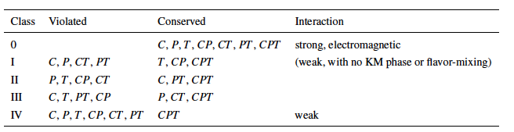
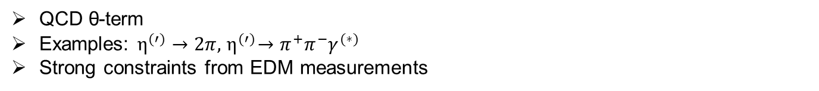
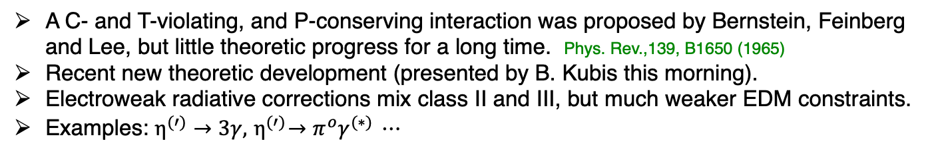
Discrete Symmetries
Class II: P-, CP-violation
QCD θ-term
Examples: $η^{(′)}→2π, { η}^{(′)}→{π^{+}π^{−}γ}^{(∗)}$
Strong constraints from EDM measurements
Class III: C-, CP-violation
A C- and T-violating, and P-conserving interaction was proposed by Bernstein, Feinberg and Lee, but little theoretic progress for a long time. Phys. Rev.,139, B1650 (1965)
Recent new theoretic development (presented by B. Kubis this morning).
Electroweak radiative corrections mix class II and III, but much weaker EDM constraints.
Examples: $η^{(′)}→3γ, { η}^{(′)}→{π^{o}γ}^{(∗)} ⋯$Lee
Class III has much weaker experimental constraint, offer an opportunity for experimental search of new physics in η decays.

Slide 6

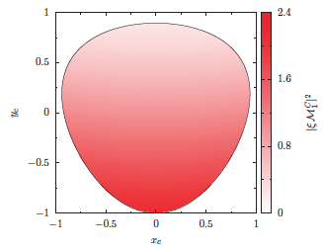
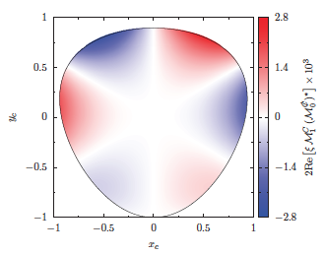
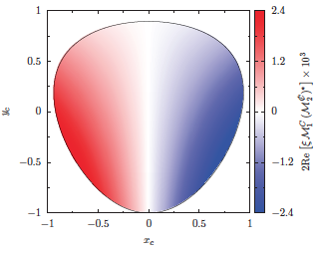
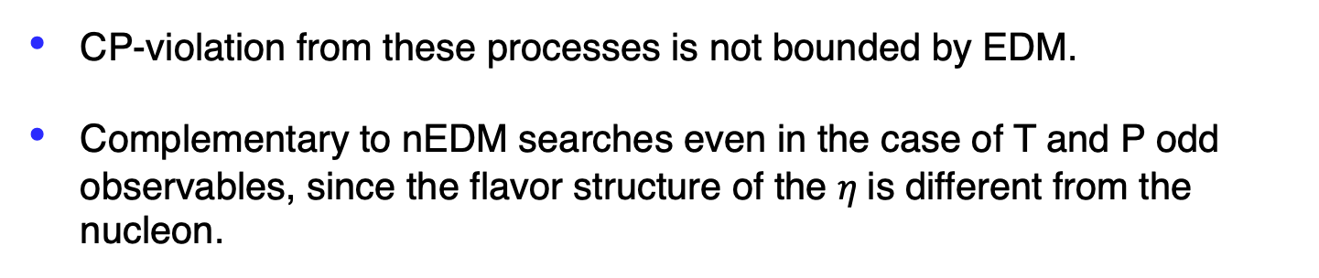
Class III: C- and CP-Violation in $η^{(′)}→π^{+}π^{−}π^{0}$, $η^{′}→π^{+}π^{−}η$
CP-violation from these processes is not bounded by EDM.
Complementary to nEDM searches even in the case of T and P odd observables, since the flavor structure of the $η$is different from the nucleon.

Slide 7
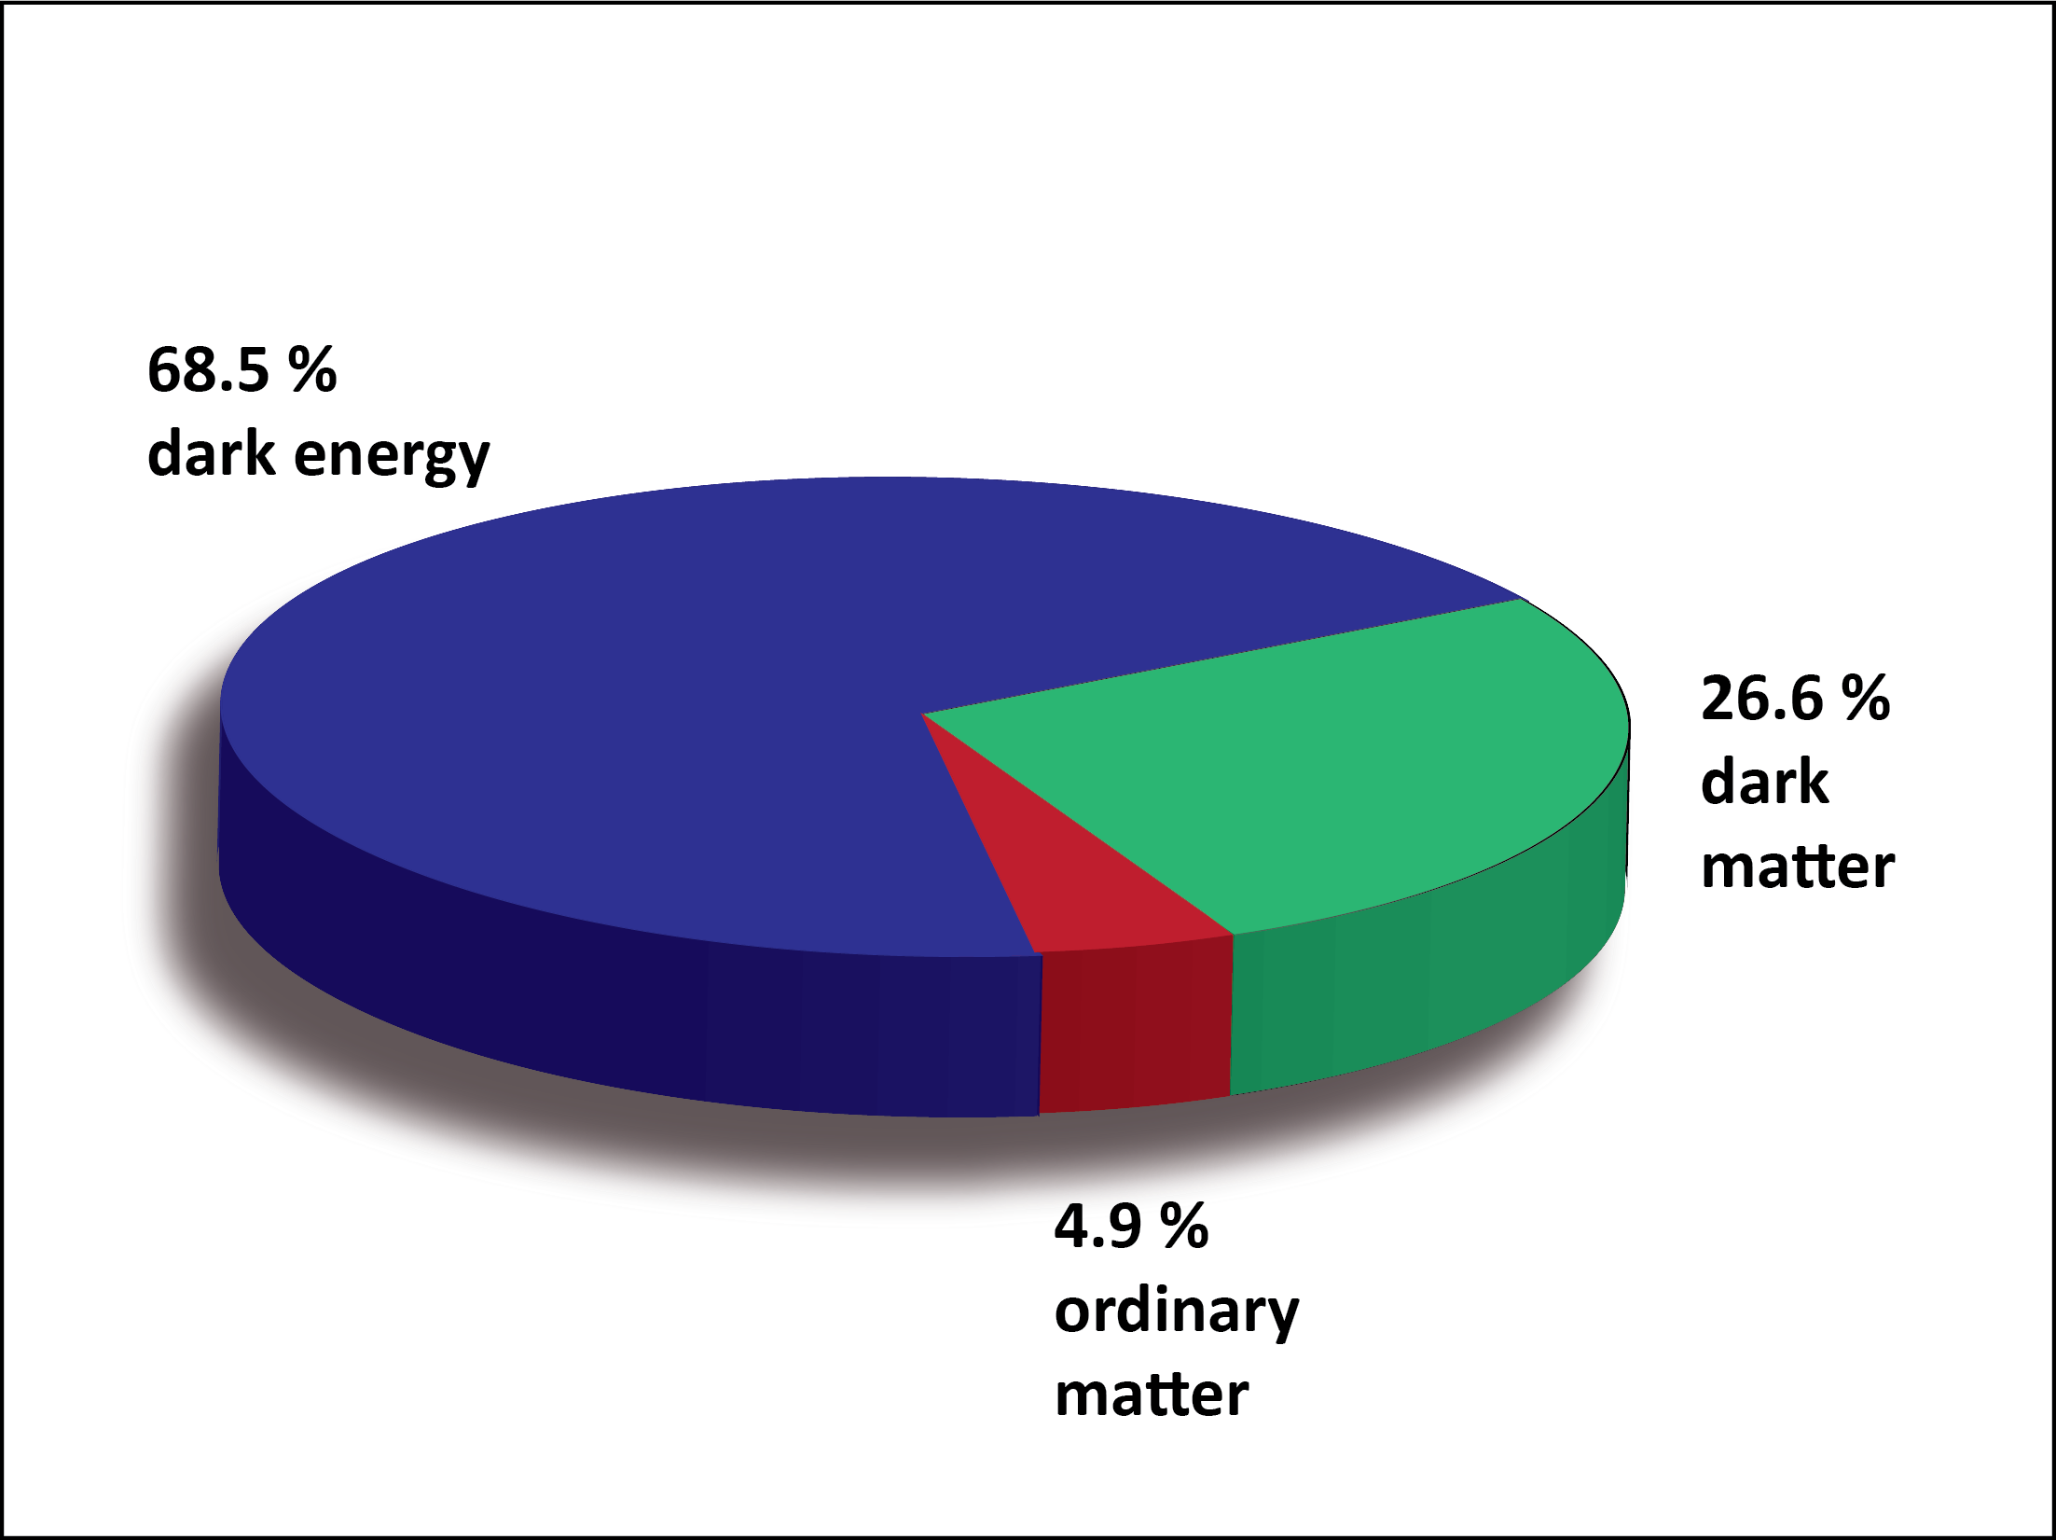
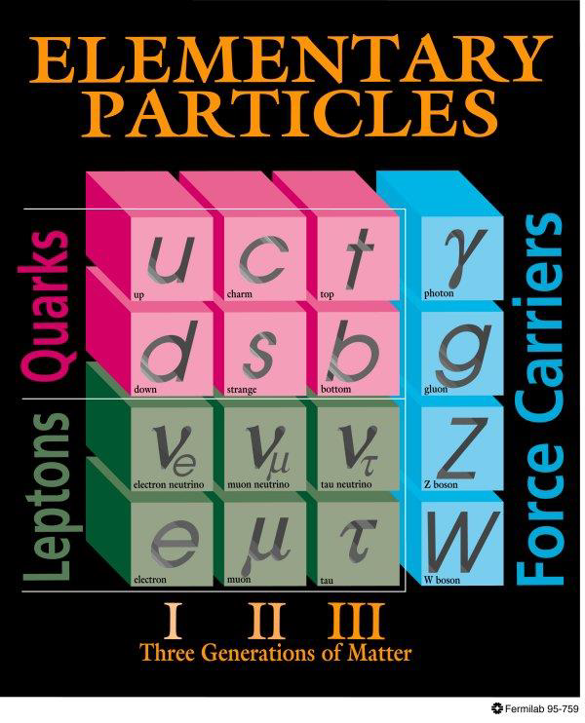
BSM Physics in Dark Sector
Dark Sector
New gauge forces, bosons and fermions beyond SM.
The stability of dark matter can be explained by the dark charge conservation.

Slide 8
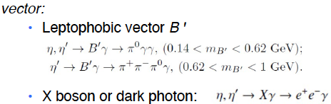


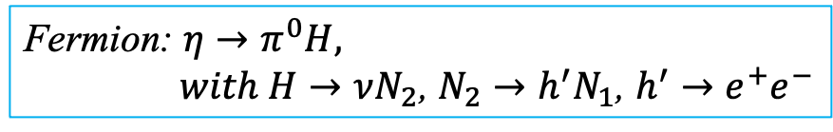
Portals Coupling SM and Dark Sector
Standard Model:
Dark Sector:
Gauge Interactions?
Dark matter?
Portals:
vector
Scalar
Fermion
ALP
Fermion: $η→π^{0}H,$
$with H→νN_{2}$, $N_{2}→h^{′}N_{1}$, $h^{′}→e^{+}e^{−}$
Phys. Rept. 945 (2022) 1-105, arXiv:2207.06905, arXiv:2203.07651

Slide 9
Landscape of BSM Physics Search
𝜋⁰, η, ηꞌ
Rept. Prog. Phys. 79, no.12, 124201
Complementary to other types of experiments, pseudoscalar mesons offer unique sensitivity for sub-GeV new physics that are flavor-conserving and light quark-coupling.

Slide 10
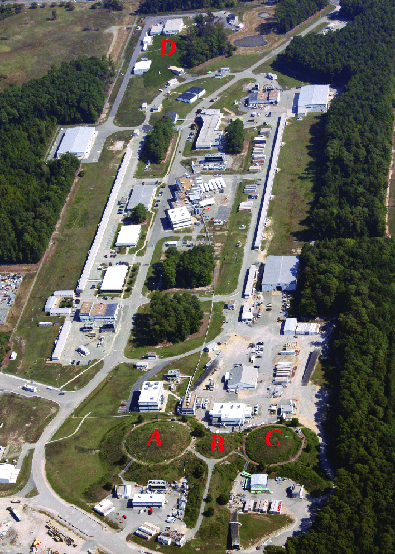
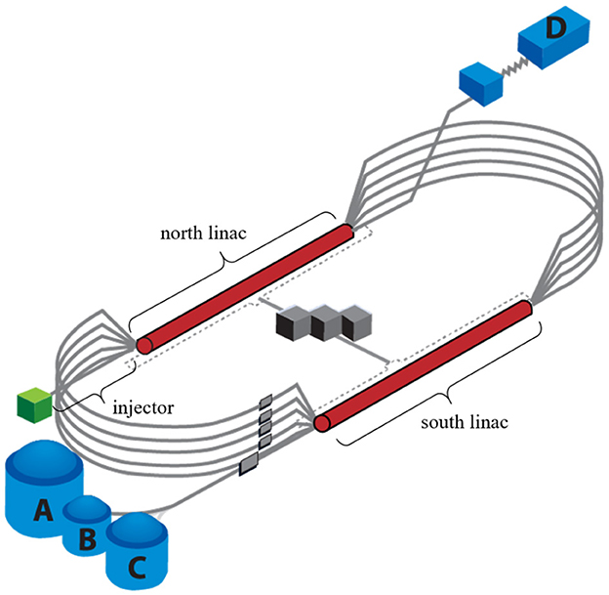
Jefferson Lab

Slide 11
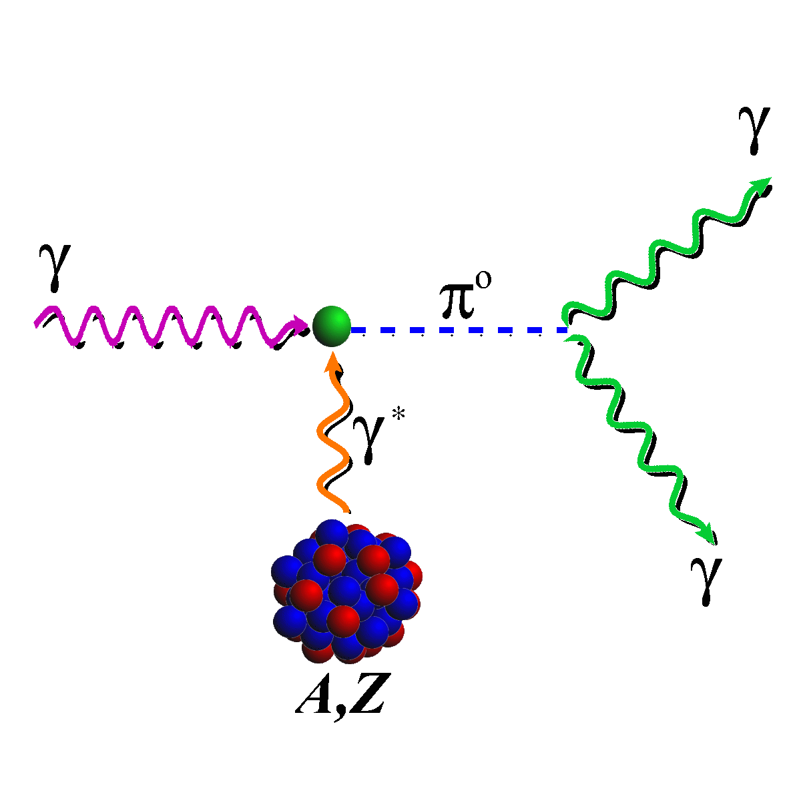
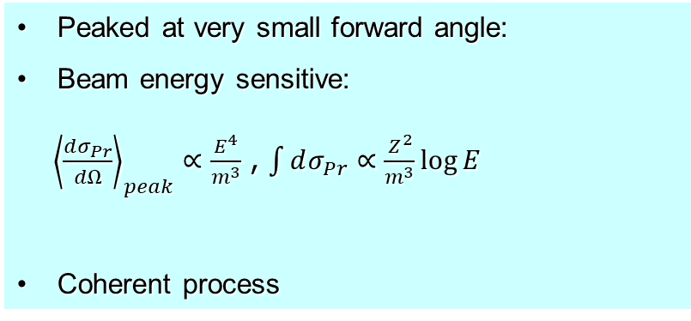
Primakoff Effect
¹²C target
ρ,ω
Primakoff
Nucl. Coherent
Nucl. Incoh.
Interference
Peaked at very small forward angle:
Beam energy sensitive:
${\left\langle \frac{dσ_{Pr}}{dΩ}\right\rangle }_{peak}∝\frac{E^{4}}{m^{3}}$ , $\int{dσ_{Pr}}∝\frac{Z^{2}}{m^{3}}\log{E}$
Coherent process
The higher beam energy is, the higher Primakoff cross section and the better separation of Primakoff from the nuclear backgrounds.
A higher beam energy is more important for more massive particle

Slide 12
PrimEx Primakoff Program at JLab 6 & 12 GeV
Precision measurements of electromagnetic properties of π⁰, η, η′ via Primakoff effect
Two-Photon Decay Widths:
  Γ(π⁰→γγ) @ 6 GeV
  Γ(η→γγ)
  Γ(η′→γγ)
Transition Form Factors
at Q² of 0.001-0.3 GeV²/c²:
F(γγ*→ π⁰), F(γγ* →η), F(γγ* →η′)
Input to Physics:
precision tests of chiral
symmetry and anomalies
light quark mass ratio
η-η′ mixing angle
input to calculate HLbL in (g-2)_{μ}
origin of the visible mass
Input to Physics:
π⁰,η and η′ electromagnetic
interaction radii
is the η′ an approximate
Goldstone boson?
input to calculate HLbL in (g-2)_{μ}
origin of the visible mass

Slide 13
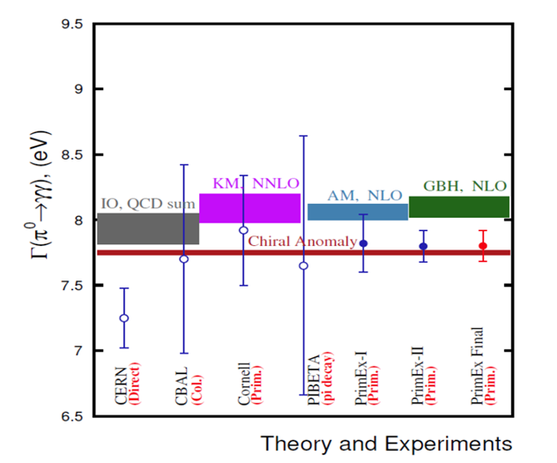
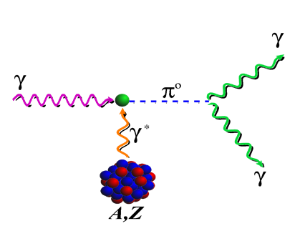
Status of Primakoff Program at JLab 6 & 12 GeV
Precision measurements of electromagnetic properties of π⁰, η, η′ via Primakoff effect
The chiral anomaly prediction is exact for massless quarks:
Γ(π⁰→γγ) is one of the few quantities in confinement region that QCD can calculate precisely at ~1% level to higher orders!
Two-Photon Decay Widths:
  Γ(π⁰→γγ) @ 6 GeV (in Hall B)
  Γ(η→γγ)
  Γ(η′→γγ)
Transition Form Factors
at Q² of 0.001-0.5 GeV²/c²:
F(γγ*→ π⁰), F(γγ* →η), F(γγ* →η′)
Science 368, 506-509 (2020)
Input to Physics:
precision tests of chiral
symmetry and anomalies
determination of light quark
mass ratio
η-η′ mixing angle
input to calculate HLbL in (g-2)_{μ}
Input to Physics:
π⁰,η and η′ electromagnetic
interaction radii
is the η′ an approximate
Goldstone boson?
input to calculate HLbL in (g-2)_{μ}
1.50% accuracy

Slide 14
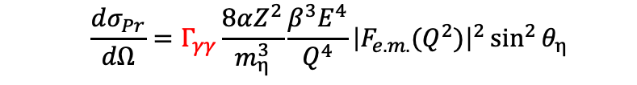

Status of Primakoff Program at JLab 6 & 12 GeV (cont.)
Precision measurements of electromagnetic properties of π⁰, η, η′ via Primakoff effect
$$ηr^{2}$$
Two-Photon Decay Widths:
  Γ(π⁰→γγ) @ 6 GeV
  Γ(η→γγ)
  Γ(η′→γγ)
$$A\frac{dσ_{Pr}}{dΩ}=Γ_{γγ}\frac{8αZ^{2}}{m_{η}^{3}}\frac{β^{3}E^{4}}{Q^{4}}{\left|F_{e.m.}(Q^{2})\right|}^{2}\sin^{2}{θ_{η}}$$
On-Going PrimEx-eta experiment (in Hall D)
A full data set was completed via three run periods in 2019, 2021 and 2022.
Data analysis is in progress.
(see talk by A. Somov on Tue)
Transition Form Factors
at Q² of 0.001-0.5 GeV²/c²:
F(γγ*→ π⁰), F(γγ* →η), F(γγ* →η′)
Input to Physics:
precision tests of chiral
symmetry and anomalies
determination of light quark
mass ratio
η-η′ mixing angle
input to calculate HLbL in (g-2)_{μ}
Input to Physics:
π⁰,η and η′ electromagnetic
interaction radii
is the η′ an approximate
Goldstone boson?
input to calculate HLbL in (g-2)_{μ}

Slide 15
Physics for Γ(η→γγ) Measurement
Resolve long standing discrepancy between previous collider and Primakoff measurements:
Extract η-η′mixing angle
Improve calculation of the η-pole contribution to Hadronic Light-by-Light (HLbL) scattering in (g-2)_{μ}
Improve all partial decay widths in the η-sector

Slide 16
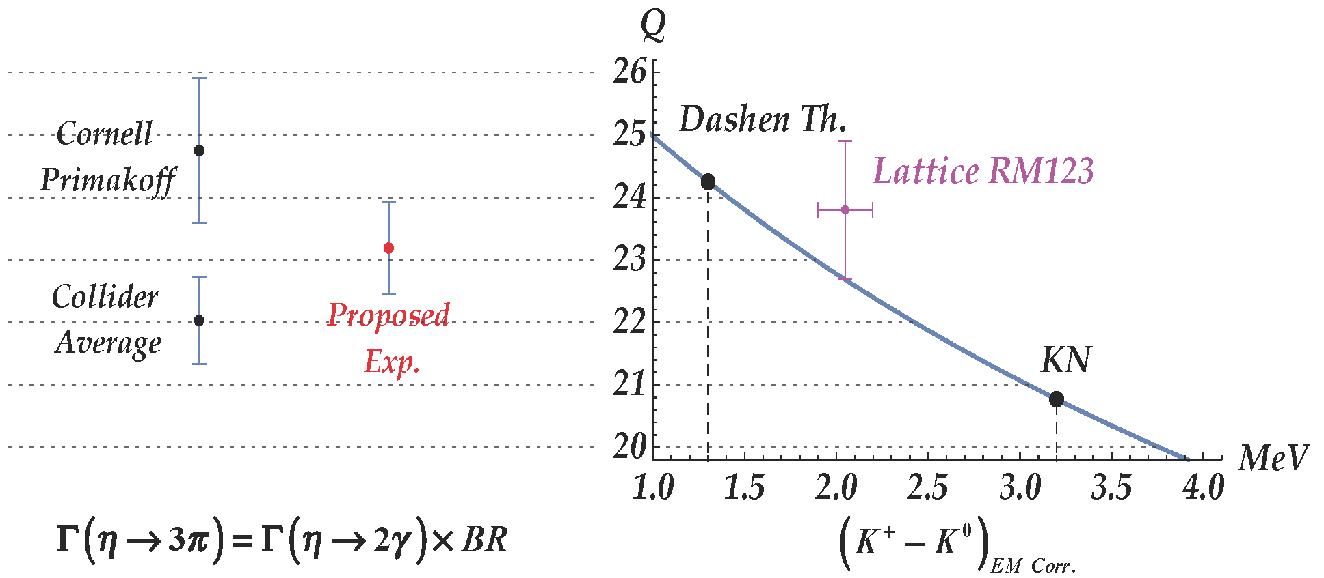
Precision Determination Light Quark Mass Ratio
  A clean probe for quark mass ratio:
    𝜂→3π decays through isospin violation:
    is small
    Amplitude:
Phys. Rept. 945 (2022) 1-105

Slide 17
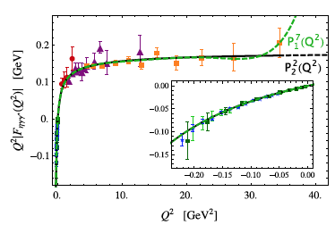
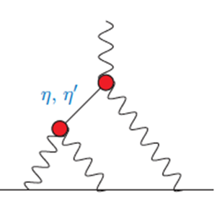
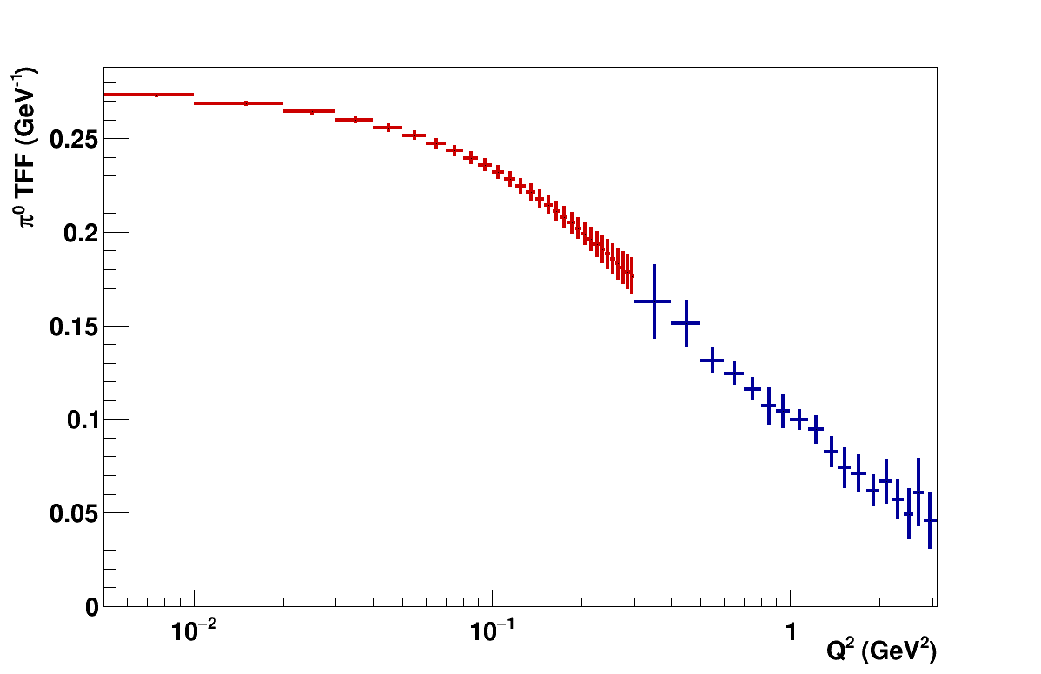
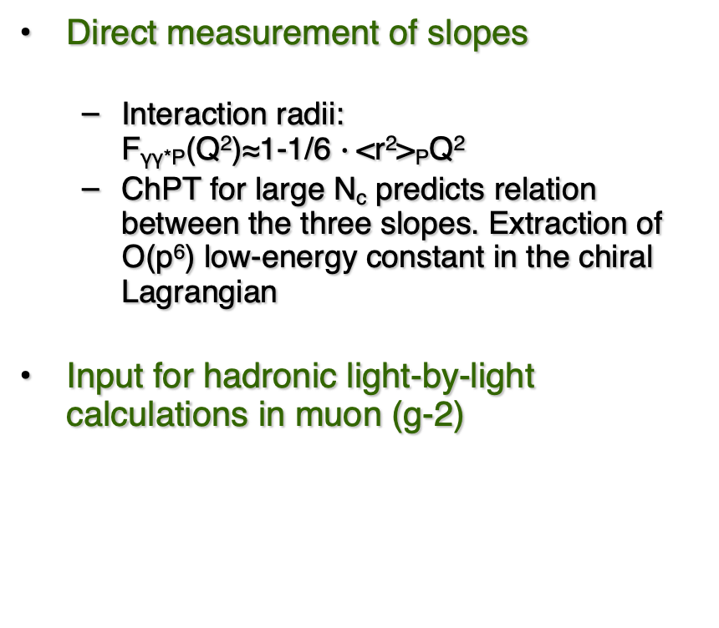
Space-Like Transition Form Factors
(Q² : 0.001-0.3 GeV²/c²)
Direct measurement of slopes
  Interaction radii:
  F_{γγ*P}(Q²)≈1-1/6 $∙$<r²>_{P}Q²
  ChPT for large N_{c} predicts relation between the three slopes. Extraction of Ο(p⁶) low-energy constant in the chiral Lagrangian
Input for hadronic light-by-light calculations in muon (g-2)
No data
$$π^{0}, η,η′$$
Projected E12-22-003 (in Hall B)
on F(γγ*→ π⁰)
Phys.Rev.D65,073034

Slide 18
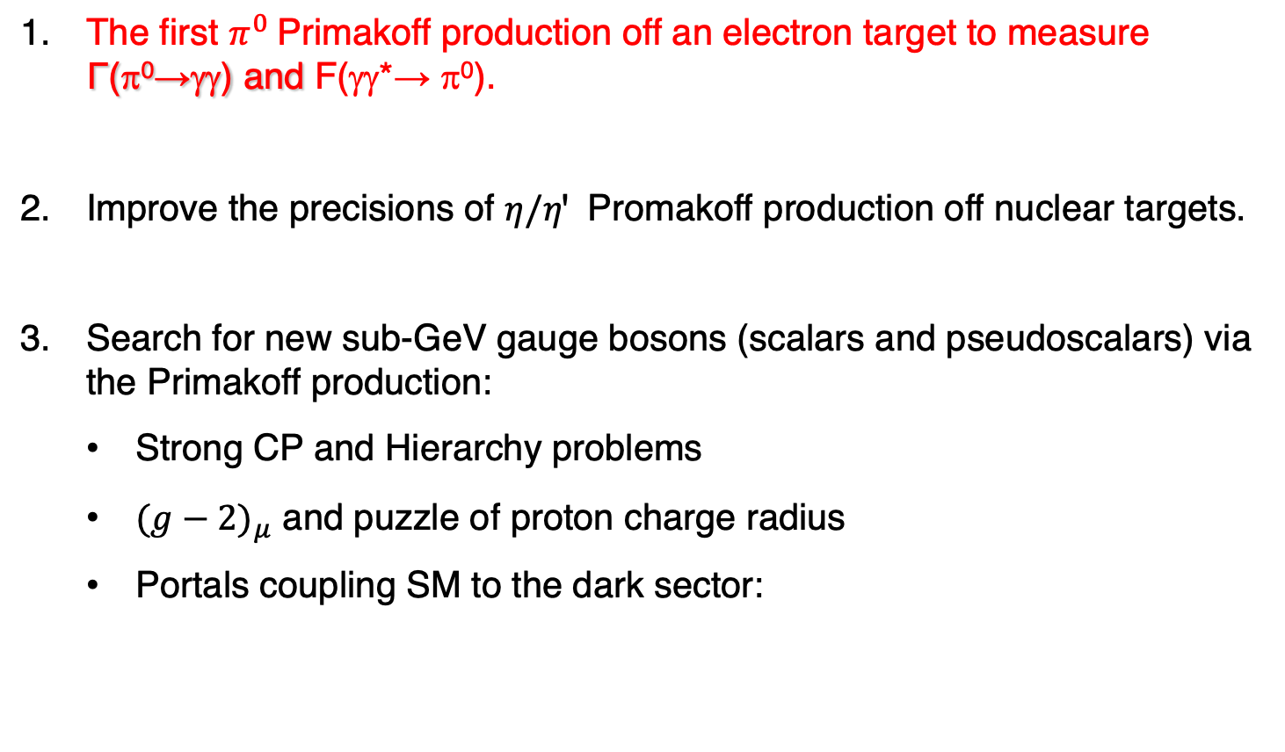
New opportunities with JLab 22 GeV Upgrade
The first $π^{0}$Primakoff production off an electron target to measure Γ(π⁰→γγ) and F(γγ*→ π⁰).
Improve the precisions of $η/ηꞌ$ Promakoff production off nuclear targets.
Search for new sub-GeV gauge bosons (scalars and pseudoscalars) via the Primakoff production:
  Strong CP and Hierarchy problems
  ${(g−2)}_{μ}$ and puzzle of proton charge radius
  Portals coupling SM to the dark sector:

Slide 19
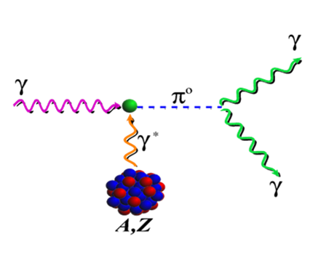
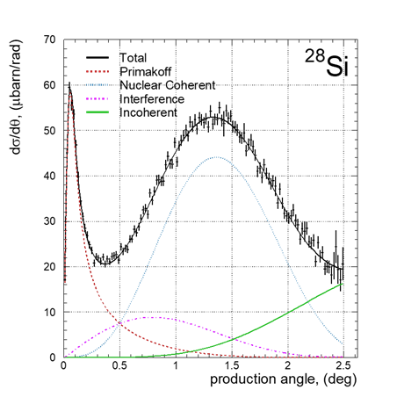
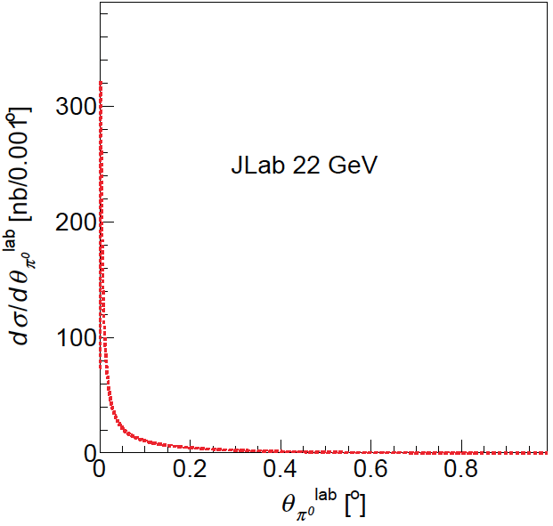

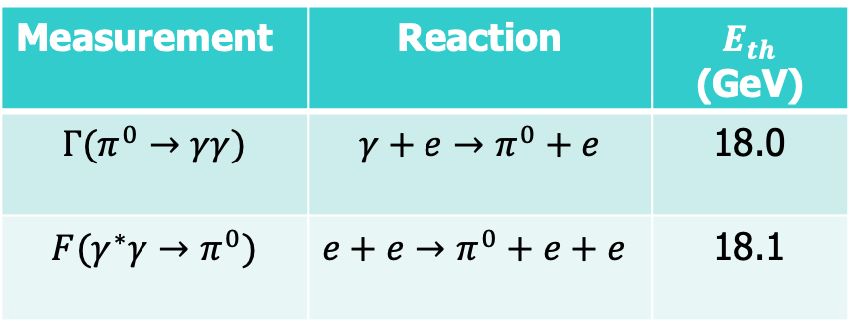



Advantages of the $π^{0}$ Primakoff Production off an Electron
Advantages of an electron target:
Eliminate all nuclear backgrounds
A point-like electron target to eliminate nuclear effects
Recoiled electron detection
PrimEx-II: ${γ+{}_{}^{28}{Si→}π}^{0}+{}_{}^{28}{Si}$
$AE_{γ}:$ 4.45-5.30 GeV
$$\frac{dσ_{Pr}}{dΩ}=Γ_{γγ}\frac{8α}{m_{π}^{3}}\frac{β^{3}E^{4}}{Q^{4}}\sin^{2}{θ_{π}}$$
$$γ+e→π^{0}+e$$
Science 368, 506-509
Measurement | Reaction | $E_{th}$ (GeV)
$$Γ(π^{0}→γγ)$$ | $${γ+e→π}^{0}+e$$ | 18.0
$$F(γ^{∗}γ→π^{0})$$ | $${e+e→π}^{0}+e+e$$ | 18.1
Main challenges for the nuclear target:
Nuclear backgrounds
Nuclear effects
No recoil detection

Slide 20
Projected $Γ\left(π^{0}→γγ\right)$ at JLab 22 GeV with an Electron Target

Slide 21
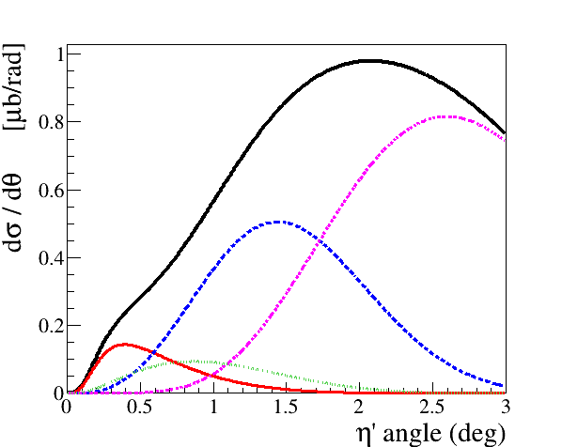
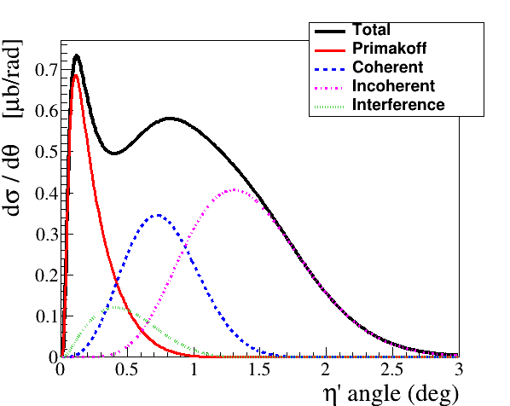

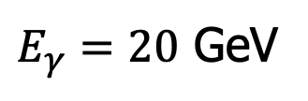
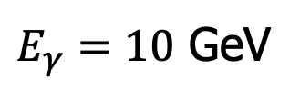
Improve Primakoff Measurements of$η/ηꞌ$ with nuclear targets
$E_{γ}=10$ GeV
$E_{γ}=20$ GeV
$$γ+{}_{}^{4}{He}→η′+{{}_{}^{4}{He}r}^{2}$$

Slide 22
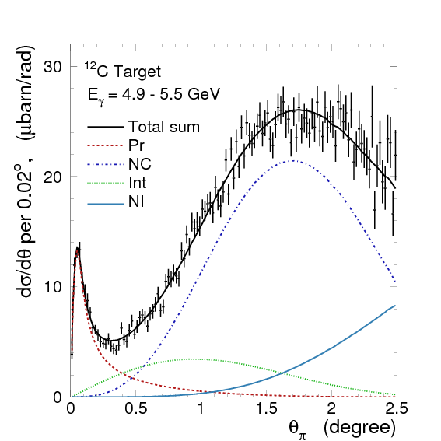
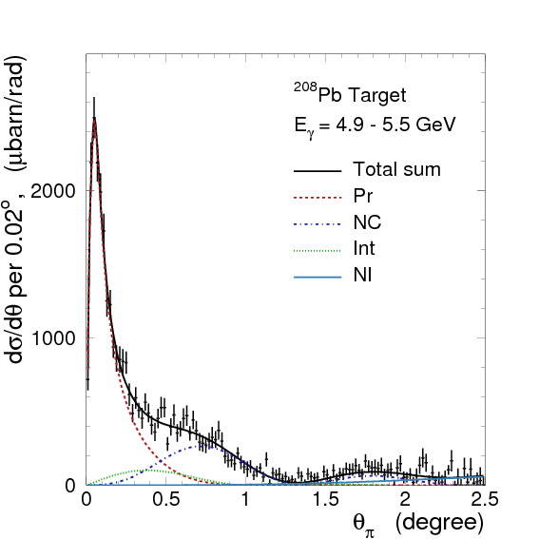

Search for sub-GeV Scalar and Pseudoscalar via Primakoff Effect
Favorable experimental condition:
A high energy beam
A high Z nuclear target
$$\frac{dσ_{Pr}}{dΩ}\sim \frac{c_{γ}^{2}αZ^{2}}{8πΛ^{2}}∙\frac{β^{3}E^{4}}{Q^{4}}∙{\left|F_{e.m.}(Q)\right|}^{2}\sin^{2}θ_{a}$$
The Primakoff signal dominates in the forward angles
¹²C
²⁰⁸Pb
PrimEx I
Minimizing the QCD backgrounds
Phys.Rev.Lett. 106 (2011) 162303

Slide 23


Projected Reach for a ALP at JLab 22 GeV
$$γ+Pb→a+Pb$$
$$a→γγ$$

Slide 24
JLab Eta Factory (JEF) Experiment at GlueX
FCAL-II
Simultaneously produce η/ηꞌ on LH₂ target with 8.4-11.7 GeV tagged photon beam via γ+p → η/ηꞌ+p
Reduce non-coplanar backgrounds by detecting recoil protons with GlueX detector
Upgraded Forward Calorimeter with High resolution, high granularity
PbWO₄ insertion (FCAL-II) to detect multi-photons from the η/ηꞌ decays
The GlueX detector will detect the charged products from the η/ηꞌ decays
24

Slide 25
Uniqueness of JEF Experiment
Suppressed backgrounds in rare neutral decays comparing to the other experiments using:
a) η/η’ energy boost; b) upgraded FCAL-II; c) recoil detection
2. Capability of running in parallel with GlueX and other experiments in Hall D
potential for a high-statistics data set
3. Simultaneously produce tagged η and ηꞌ with similar rates
(~5x10⁵ per day)

Slide 26
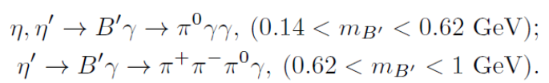

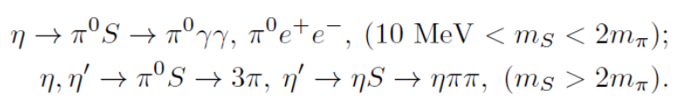





Main JEF Physics Objectives
1. Search for sub-GeV hidden bosons
vector:
    Leptophobic vector B ꞌ
    Hidden or dark photon:
scalar S:
Axion-Like Particles (ALP):
2. Directly constrain CVPC new physics:
3. Precision tests of low-energy QCD:
  Interplay of VMD & scalar dynamics in ChPT:
  Transition Form Factors of η⁽ꞌ⁾ :
4. Improve the light quark mass ratio via Dalitz distributions of η→3π
$$η^{(′)}→3γ,{ η}^{(′)}→2π^{0}γ,{ η}^{(′)}→π^{+}π^{−}π^{0}$$

Slide 27
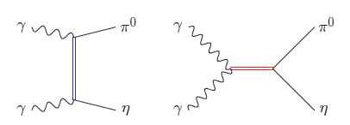
Example of a Key Channel: η→π⁰γγ
New physics:
Search for sub-GeV gauge bosons
  A leptophobic vector B’:
  η→γB’, B’ →π⁰γ
  An electrophobic scalar Φ’:
  η→π⁰Φ’, Φ’→γγ
  PRL 117,101801 (2016); PL B740,61(2015)
Standard Model:
Dark Sector:
Gauge Interactions?
Dark matter?
PR,D89,114008
Portal:
vector
Scalar
fermion
Confinement QCD:
a₀, a₂
A rare window to probe interplay of VMD & scalar resonance in ChPT
ρ, ω
Gasser, Leutwyler 84; Ecler, Gasser, Pich, de Rafael1989; Donoghue, Ramirez, Valencia 1989

Slide 28
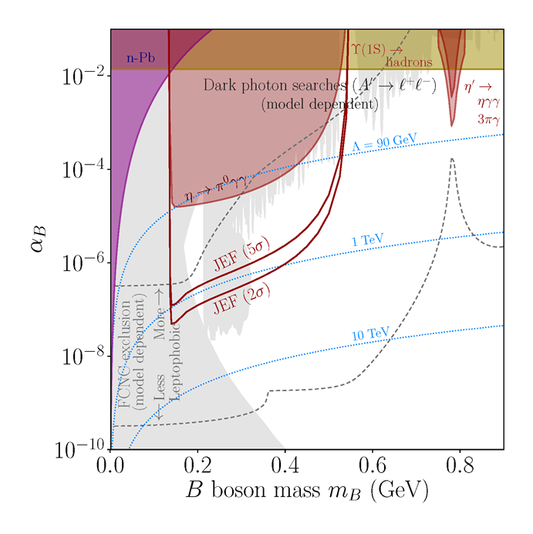
JEF Experimental Reach for B’
A search for a leptophobic dark B’ boson coupled to baryon number is complementary to ongoing searches for a dark photon
η→ B’γ →π⁰γγ
B’
γ
PL, B221, 80 (1989)
PR,D89,114008

Slide 29
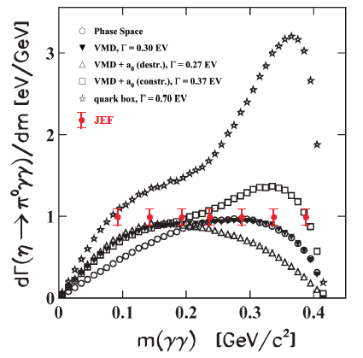
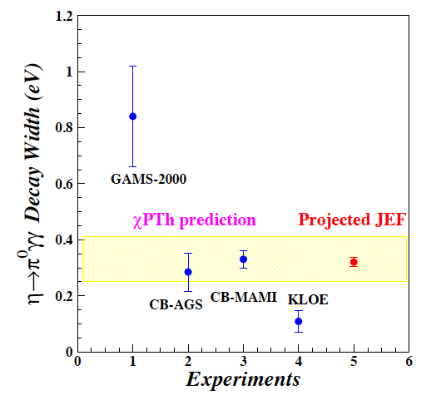
Projected JEF on SM Allowed η→π⁰γγ
J.N. Ng and D.J. Peters, Phys. Rev. D47, 4939
χPTh by Oset et al., Phys. Rev. D77, 073001
We measure both BR and Dalitz distribution
model-independent determination of two LEC’s of the O(p⁶) counter- terms
probe the role of scalar resonances to calculate other unknown O(p⁶) LEC’s
J. Bijnens, talk at AFCI workshop

Slide 30
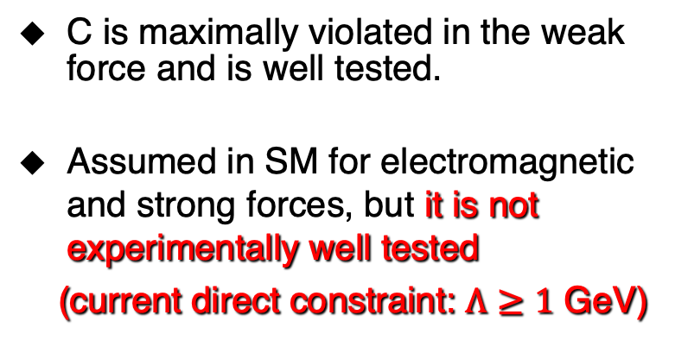
Test Charge Conjugation Invariance
C Violating η neutral decays
Mode | Branching Ratio (upper limit) | No. γ’s
3γ | < 1.6•10⁻⁵ | 3
π⁰γ | < 9•10⁻⁵
2π⁰γ | < 5•10⁻⁴ | 5
3γπ⁰ | Nothing published
3π⁰γ | < 6•10⁻⁵ | 7
3γ2π⁰ | Nothing published
C is maximally violated in the weak force and is well tested.
Assumed in SM for electromagnetic and strong forces, but it is not experimentally well tested
(current direct constraint: $Λ≥1$ GeV)

Slide 31
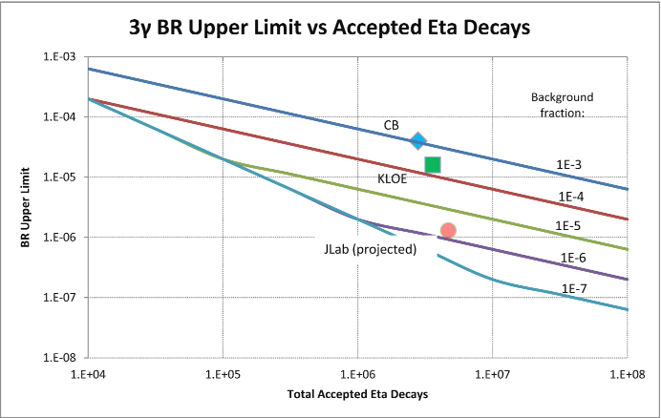
Experimental Improvement on C-violating η→3γ
SM contribution:
BR(η→3γ) <10⁻¹⁹ via P-violating
weak interaction.
A calculation due to new
physics by Tarasov suggests:
BR(η→3γ)< 10⁻²
Sov.J.Nucl.Phys.,5,445 (1967)
Proj. JEF
Improve BR upper limit by one order of magnitude to directly tighten the constraint on CVPC new physics

Slide 32
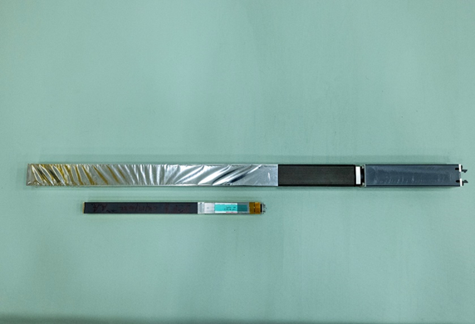
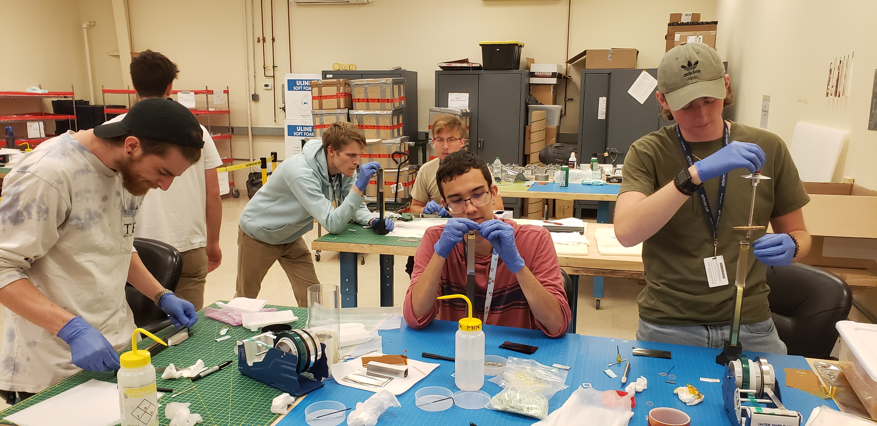
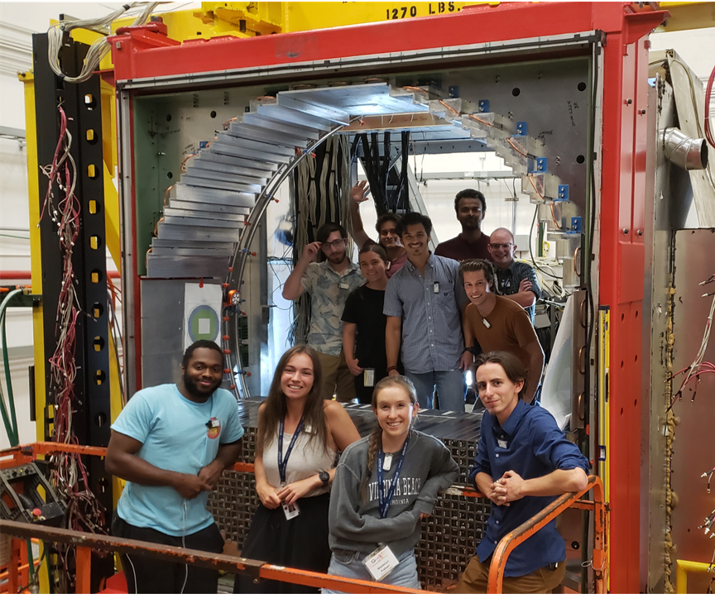
Status of the JEF Experiment
Developed an upgraded FCAL-II with a PbWO₄ insert.:
Undergraduate workforce
  1596 PbWO₄ modules are developed to replace ~400 Pb-glass modules.
  Installation of the upgraded FCAL-II has been on-going since Mar 2023 and will be completed by the end of 2024.
  Over 40 undergraduate students from 11 institutes were trained by involving in this project.
Pb-glass module (4x4x45 cm³)
PbWO₄ module (2x2x20 cm³)
May 2023
Oct 6, 2023
  Commissioning of FCAL-II and data taking with FCAL-II are scheduled to start in Jan 2025.

Slide 33
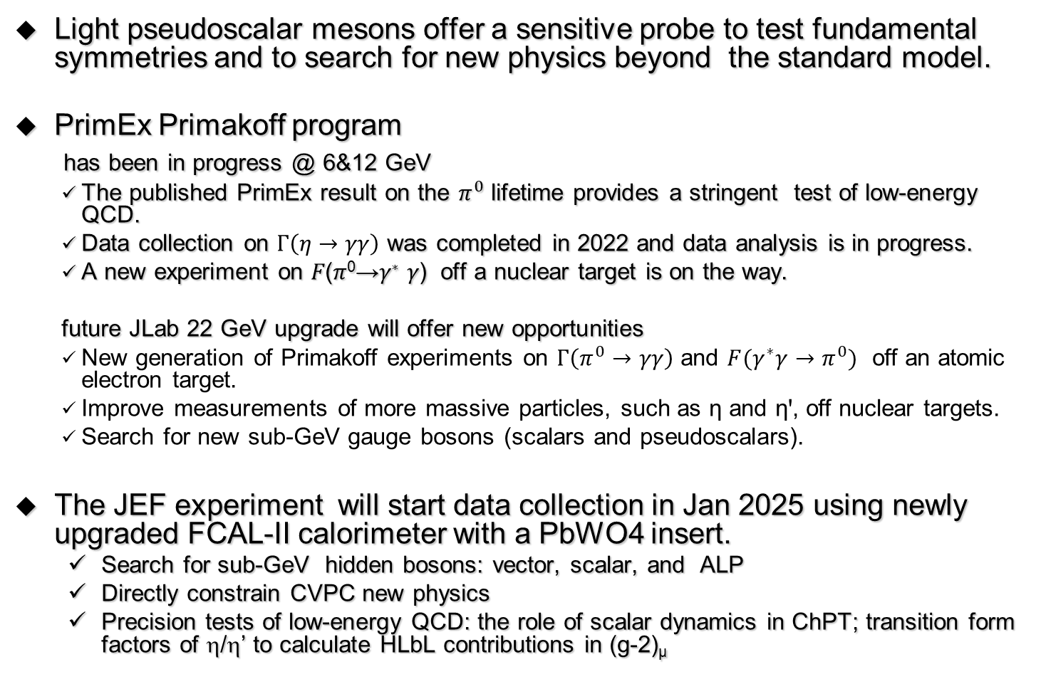
Summary
Light pseudoscalar mesons offer a sensitive probe to test fundamental symmetries and to search for new physics beyond the standard model.
PrimEx Primakoff program
has been in progress @ 6&12 GeV
  The published PrimEx result on the $π^{0}$ lifetime provides a stringent test of low-energy QCD.
  Data collection on $Γ\left(η→γγ\right)$ was completed in 2022 and data analysis is in progress.
  A new experiment on 𝐹(𝜋⁰→𝛾∗ 𝛾) off a nuclear target is on the way.
  future JLab 22 GeV upgrade will offer new opportunities
  New generation of Primakoff experiments on $Γ\left(π^{0}→γγ\right)$ and $F(γ^{∗}γ→π^{0})$ off an atomic electron target.
  Improve measurements of more massive particles, such as η and ηꞌ, off nuclear targets.
  Search for new sub-GeV gauge bosons (scalars and pseudoscalars).
The JEF experiment will start data collection in Jan 2025 using newly upgraded FCAL-II calorimeter with a PbWO4 insert.
  Search for sub-GeV hidden bosons: vector, scalar, and ALP
  Directly constrain CVPC new physics
  Precision tests of low-energy QCD: the role of scalar dynamics in ChPT; transition form factors of η/η’ to calculate HLbL contributions in (g-2)_{μ}

