Slide 1

Low Q² Spin Structure Results from
David Ruth
Chiral Dynamics Workshop 2024
8/30/24

Slide 2
Testing Chiral Perturbation Theory with Polarizabilities
How good are our low Q² effective theories of QCD? We need data benchmarks to check…
𝛘PT and other theoretical calculations can be directly compared to data for Spin Polarizabilities
Polarizabilities describe a nucleon’s ensemble response to an external field
Spin Polarizabilities can be accessed with sum rule integrals of Spin Structure Functions experimentally measured with Inclusive Electron Scattering
Proton
B-Field
Proton

Slide 3

Spin Structure Functions
In unpolarized systems, the inclusive electron scattering cross section can be written with
F₁ and F₂ structure functions describing the internal dynamics of a nucleon:
In a spin-½ polarized system, two additional structure functions describe the spin structure of the nucleon:
Mostly from longitudinal polarization
Mostly from transverse polarization
Moments of g₁ and g₂ are one of the best options to test effective theories!

Slide 4


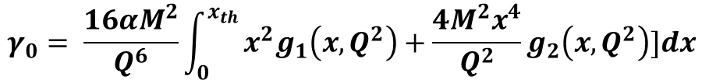
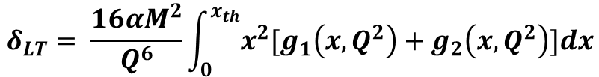
Moments & Polarizabilities
Super-convergence Sum Rules
$$I_{1}\left(Q^{2}=0\right)= \frac{2M^{2}}{Q^{2}}\int_{0}^{1}{g_{1}\left(x,Q^{2}\right)dx}=\frac{2π^{2}ακ^{2}}{M^{2}}$$
Gerasimov-Drell-Hearn Sum Rule
$$Γ_{2}(Q^{2})= \int_{0}^{1}{g_{2}\left(x,Q^{2}\right)dx=0}$$
Burkhardt-Cottingham Sum Rule
Polarizabilities & Higher Moments
$$δ_{LT}= \frac{16αM^{2}}{Q^{6}}\int_{0}^{x_{th}}{x^{2}[g_{1}\left(x,Q^{2}\right)+g_{2}\left(x,Q^{2}\right)]dx}$$
Transverse-Longitudinal Spin Polarizability
$$γ_{0}= \frac{16αM^{2}}{Q^{6}}\int_{0}^{x_{th}}{x^{2}g_{1}\left(x,Q^{2}\right)+{\frac{4M^{2}x^{4}}{Q^{2}}g}_{2}\left(x,Q^{2}\right)]dx}$$
Generalized Forward Spin Polarizability
$$\overline{d_{2}}= \int_{0}^{x_{th}}{x^{2}[{2g}_{1}\left(x,Q^{2}\right)+{3g}_{2}\left(x,Q^{2}\right)]dx}$$
Color Polarizability / Twist-3 Matrix Element

Slide 5
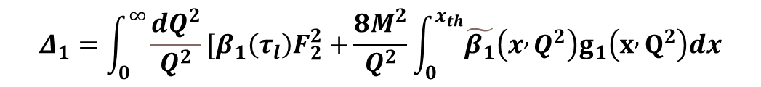

Moments & Polarizabilities
Hyperfine Structure Contributions
$$Δ_{1}=\int_{0}^{∞}{\frac{dQ^{2}}{Q^{2}}[β_{1}\left(τ_{l}\right)F_{2}^{2}+}\frac{8M^{2}}{Q^{2}}\int_{0}^{x_{th}}{\tilde{β_{1}}\left(x , Q^{2}\right)g_{1}\left(x , Q^{2}\right)dx}$$
$$Δ_{2}=−24M^{2}\int_{0}^{∞}{\frac{dQ^{2}}{Q^{4}}}\int_{0}^{x_{th}}{\tilde{β_{2}}\left(x , Q^{2}\right)g_{2}\left(x , Q^{2}\right)dx}$$
$$Δ_{pol}=\frac{αm_{l}}{2π\left(1+κ\right)M}(Δ_{1}+Δ_{2})$$
Dominating Source of Hydrogen Hyperfine Splitting Uncertainty!

Slide 6
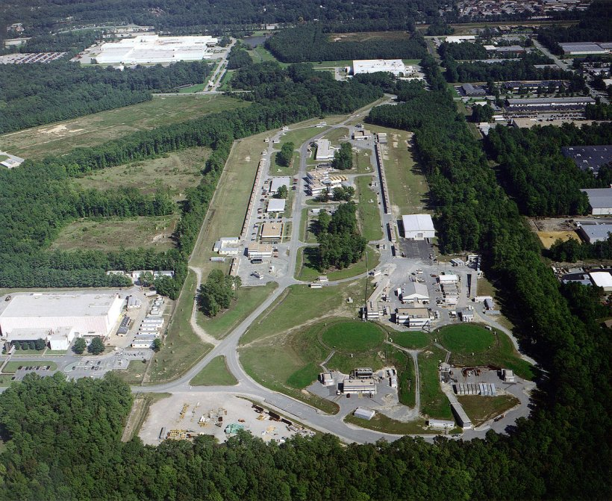
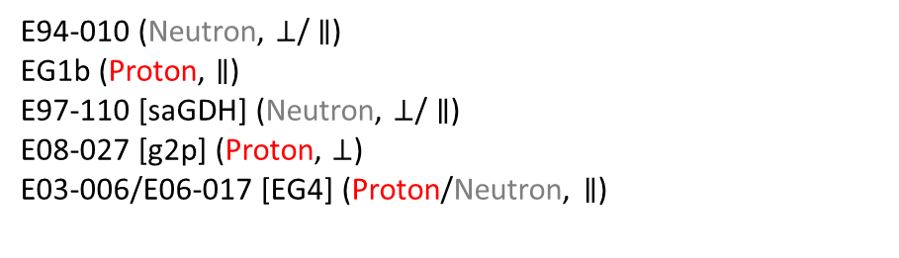
Thomas Jefferson National Accelerator Facility
is a premier facility in Newport News, VA, USA for electron scattering experiments
1400 Meter “Racetrack” Linear Accelerator with 4 experimental halls
Spin polarized electron beam with energy
up to 12 GeV
Current ranges from 50 nA – 85 uA
Host to a number of completed experiments measuring spin structure functions at low Q²:
E94-010 (Neutron, $⊥$/ $∥$)
EG1b (Proton, $∥$)
E97-110 [saGDH] (Neutron, $⊥$/ $∥$)
E08-027 [g2p] (Proton, $⊥$)
E03-006/E06-017 [EG4] (Proton/Neutron, $∥$)

Slide 7



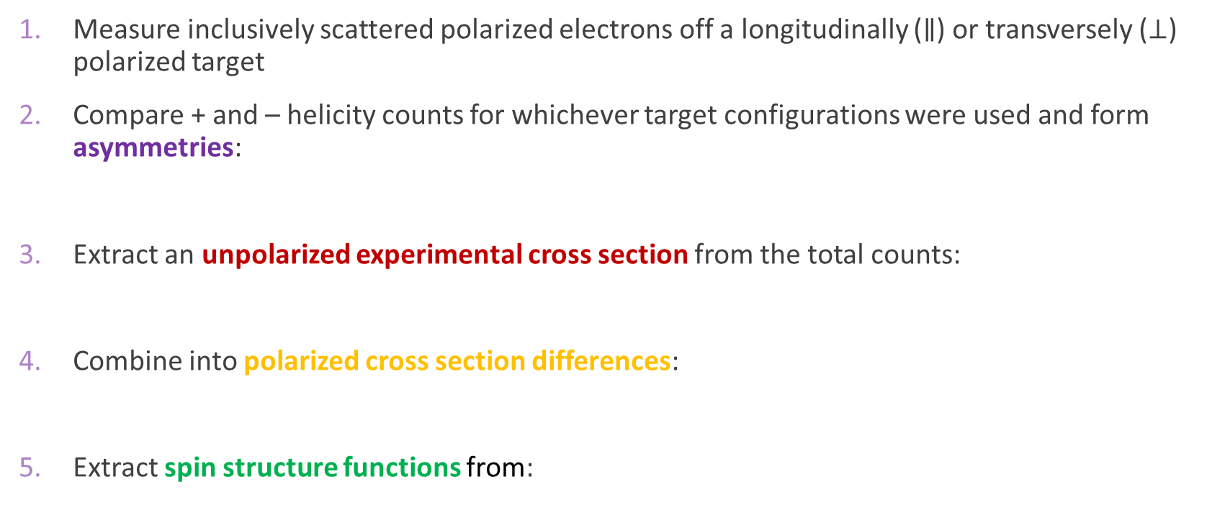




General Extraction Procedure
Measure inclusively scattered polarized electrons off a longitudinally ($∥$) or transversely ($⊥$) polarized target
Compare + and – helicity counts for whichever target configurations were used and form asymmetries:
Extract an unpolarized experimental cross section from the total counts:
Combine into polarized cross section differences:
Extract spin structure functions from:
$$A_{⊥} =\frac{σ^{↑⇒}−σ^{↓⇒}}{σ^{↑⇒}+σ^{↓⇒}}$$
$$A_{∥} =\frac{σ^{↑⇑}−σ^{↓⇑}}{σ^{↑⇑}+σ^{↓⇑}}$$
$$\frac{d2σ}{dΩdE′}=\frac{(ps)N}{N_{in}ρ(LT)ε_{det}}\frac{f}{ΔΩΔE′ΔZ}$$
(Or use world data for unpolarized part)
$${∆σ}_{⊥} =2A_{⊥}σ_{0}$$
$${∆σ}_{∥} =2A_{∥}σ_{0}$$
(EG4 directly measured these cross section differences)
$$Δσ_{⊥}=\frac{4α^{2}}{MνQ^{2}}\frac{{E′}^{2}}{E}\sin{θ}\left[νg_{1}\left(x,Q^{2}\right)−2Eg_{2}(ν,Q^{2})\right]$$
$$Δσ_{∥}=\frac{4α^{2}}{MνQ^{2}}\frac{E′}{E}\left[g_{1}\left(x,Q^{2}\right)\left\{E+E^{′\cos{θ}}\right\}−\frac{Q^{2}}{ν}g_{2}(ν,Q^{2})\right]$$

Slide 8
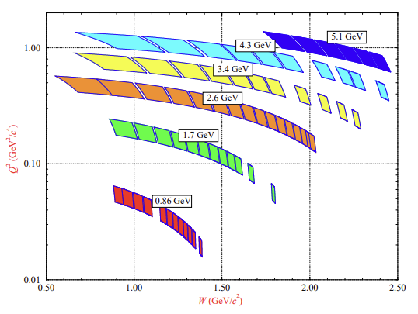
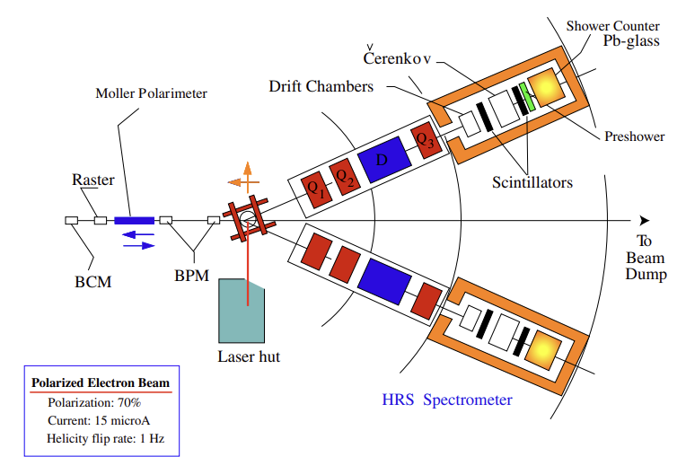
E94-010 Experiment
Ran in 1998 in Hall A
Polarized ³He Target used to extract neutron structure functions
Scattered electrons measured with Hall A High Resolution Spectrometers
Spins of the two protons in ³He are antialigned in ground state, so spin is dominated by the neutron
K. Slifer Ph.D. Thesis (2004)
First look at intermediate to low Q² neutron spin structure!

Slide 9
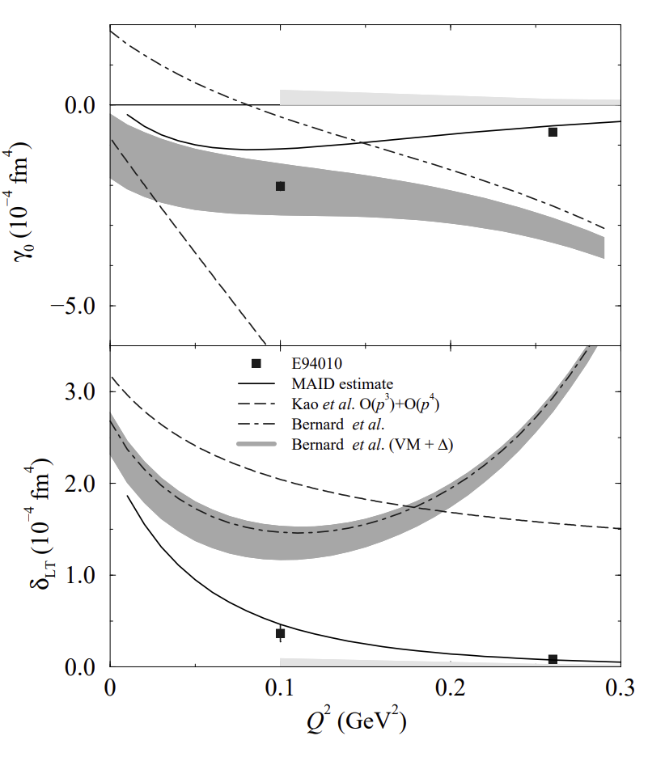
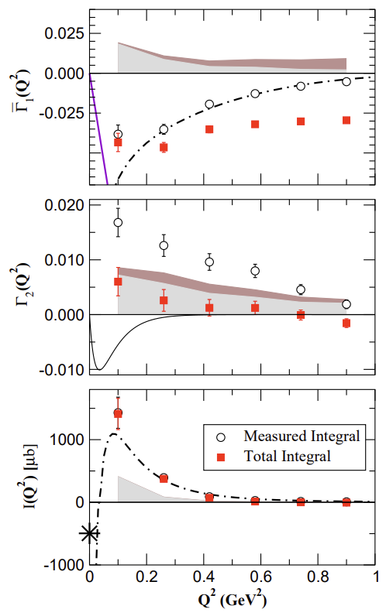
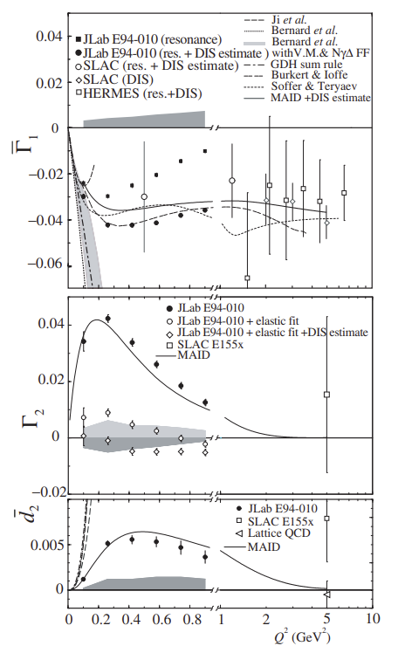
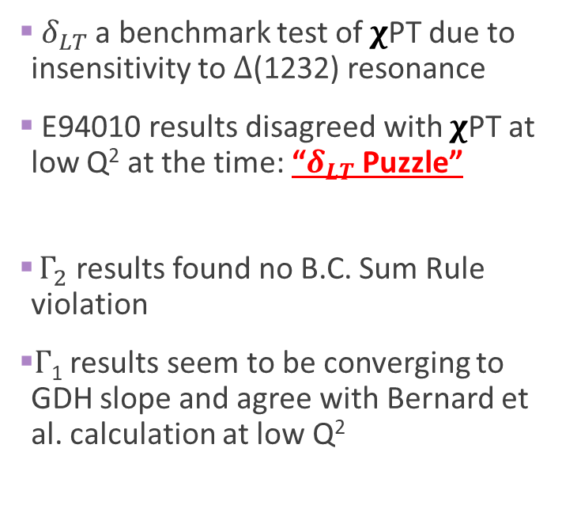
E94-010 Results
M. Amarian et al., Phys. Rev. Lett. 93, 152301 (2008)
M. Amarian et al., Phys. Rev. Lett. 92, 022301 (2004)
$δ_{LT}$ a benchmark test of 𝛘PT due to insensitivity to $Δ$(1232) resonance
E94010 results disagreed with 𝛘PT at low Q² at the time: “$δ_{LT}$ Puzzle”
$Γ_{2}$ results found no B.C. Sum Rule violation
$Γ$₁ results seem to be converging to GDH slope and agree with Bernard et al. calculation at low Q²

Slide 10
What about the proton?

Slide 11
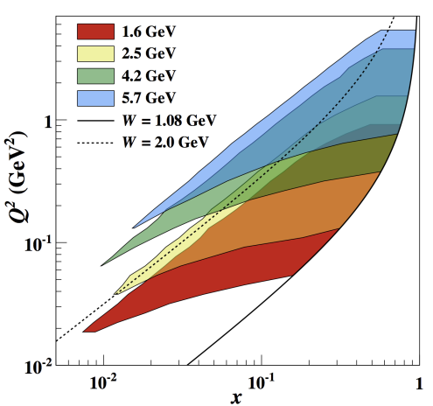
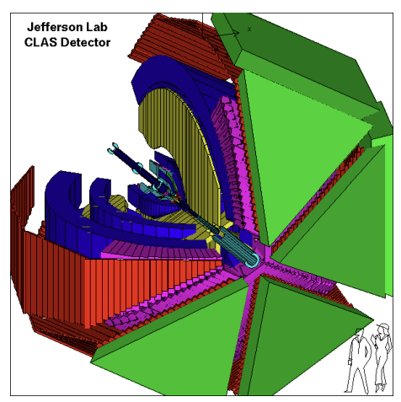
EG1b Experiment
R. Fersch et al., Phys. Rev. C 96, 065208 (2017)
As for the proton, first low Q² results from JLab came from the EG1b experiment in
Hall B which ran in 2000-2001
CLAS: A large acceptance spectrometer based on a six coil toroidal superconducting magnet
Longitudinally polarized solid Ammonia (NH₃ or ND₃) target
Polarized with dynamic nuclear polarization
Full results published in 2017!

Slide 12
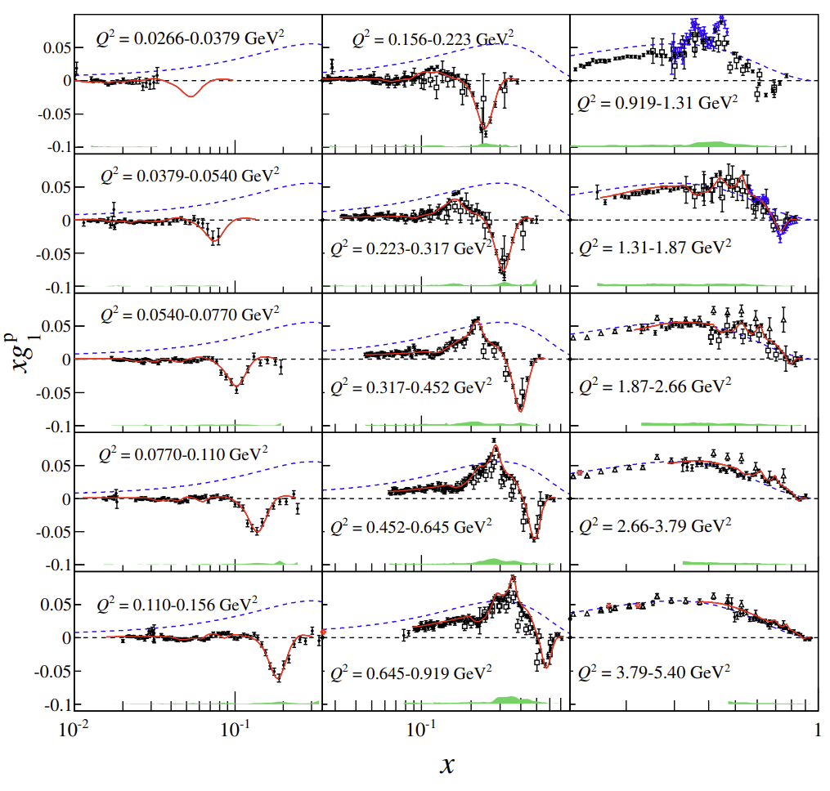
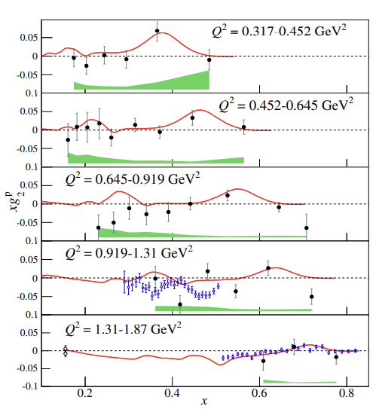
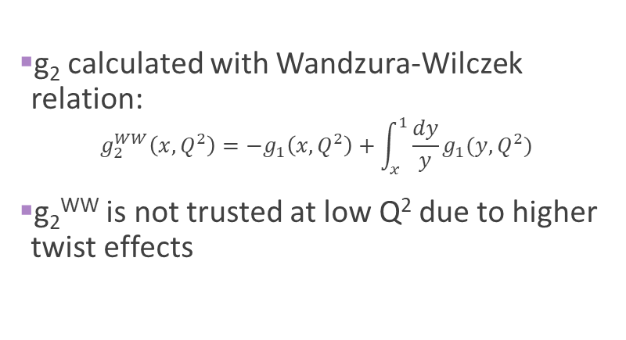
EG1b Structure Function Results
g₁ measured directly over a very large range with excellent resolution in Q²
Primarily resonance region results
g₂ calculated with Wandzura-Wilczek relation:
$g_{2}^{WW}\left(x,Q^{2}\right)=−g_{1}\left(x,Q^{2}\right)+\int_{x}^{1}{\frac{dy}{y}g_{1}(y,Q^{2})}$
g₂^{WW} is not trusted at low Q² due to higher twist effects
R. Fersch et al., Phys. Rev. C 96, 065208 (2017)

Slide 13
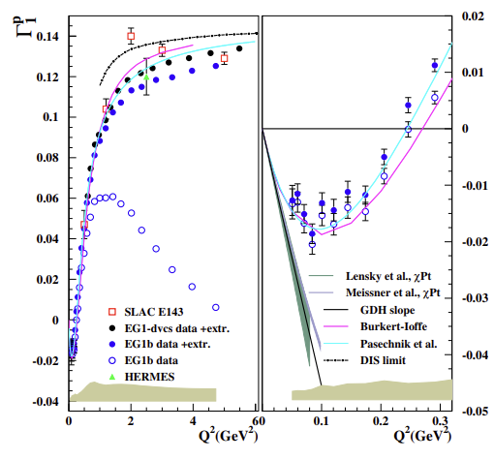
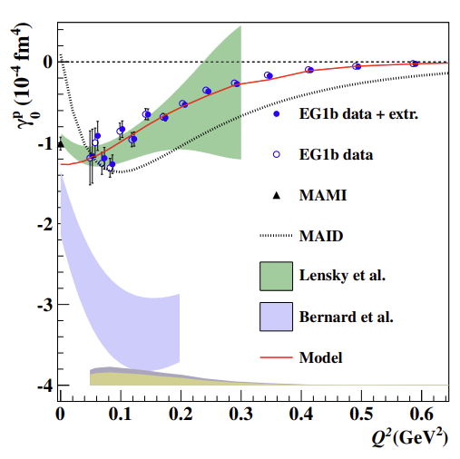
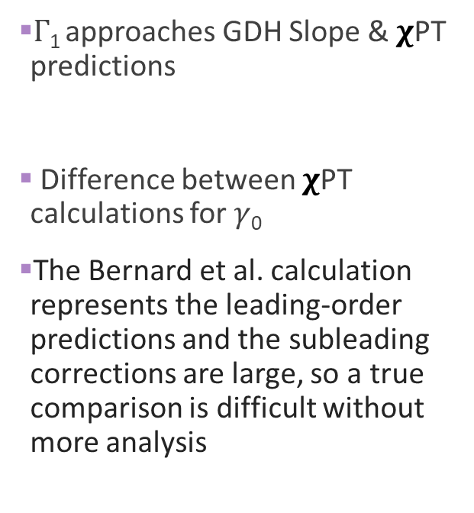
EG1b Moment Results
R. Fersch et al., Phys. Rev. C 96, 065208 (2017)
$Γ$₁ approaches GDH Slope & 𝛘PT predictions
Difference between 𝛘PT calculations for $γ$₀
The Bernard et al. calculation represents the leading-order predictions and the subleading corrections are large, so a true comparison is difficult without more analysis

Slide 14
Can we go to even smaller Q² with the neutron?

Slide 15
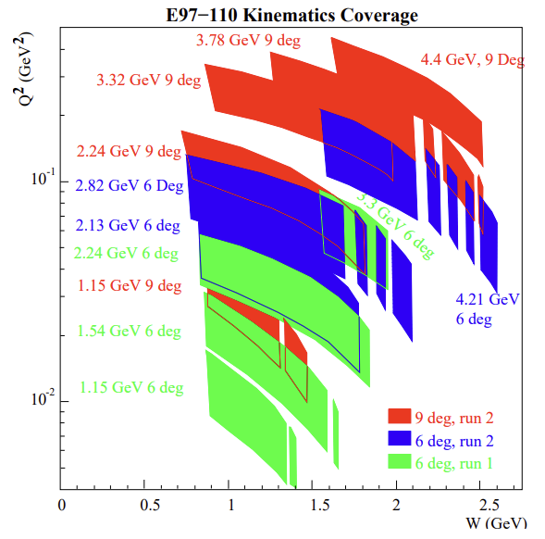
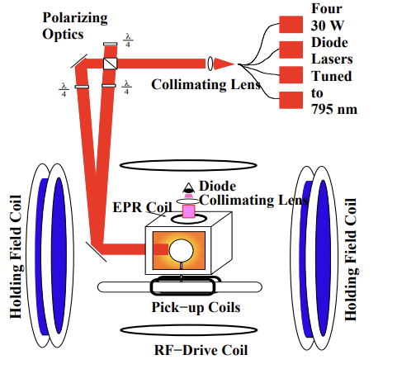
E97-110 Experiment (Small-Angle GDH)
Neutron (³He) target with both longitudinal and transverse polarization through spin-exchange optical pumping
Due to small scattering angle, covers almost an order of magnitude lower in Q²
than E94-010
Ran in Hall A in 2003, published in Nature Physics in 2021
Septum magnet allows small scattering angles down to 6 degrees with the Hall A High Resolution Spectrometers
V. Sulkosky Ph.D. Thesis (2007)

Slide 16
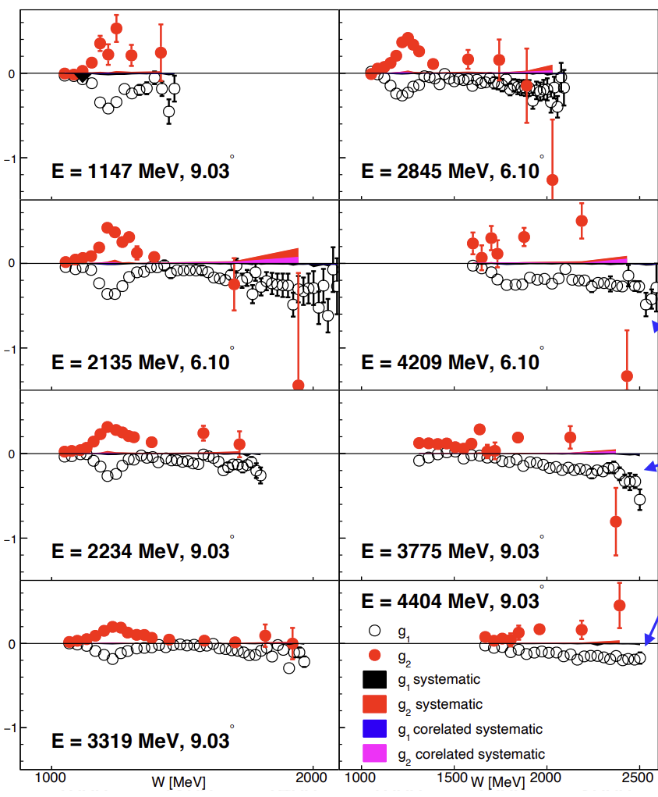
Small-Angle GDH Results (SSF)
A. Deur Hadron24, Dalian, China, 08/07/2024
As before, assume proton contributions cancel, so ³He SSF are dominated by Neutron
g₁ and g₂ are approximately equal and opposite

Slide 17
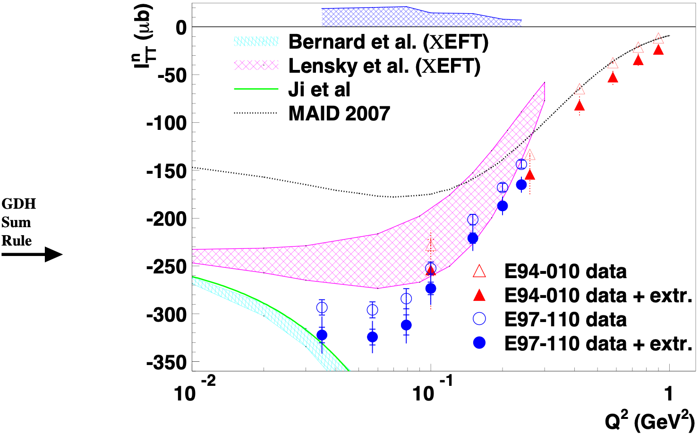
Small-Angle GDH – GDH Sum Rule
A. Deur low-Q 2023, 18 May 2023, courtesy J.P. Chen
Agrees with older data at high Q²
Agrees with the Lensky at al. calculation only at high Q²
Agrees with the Bernard et al. calculation only at lowest Q²
MAID does not agree with any of the new data

Slide 18
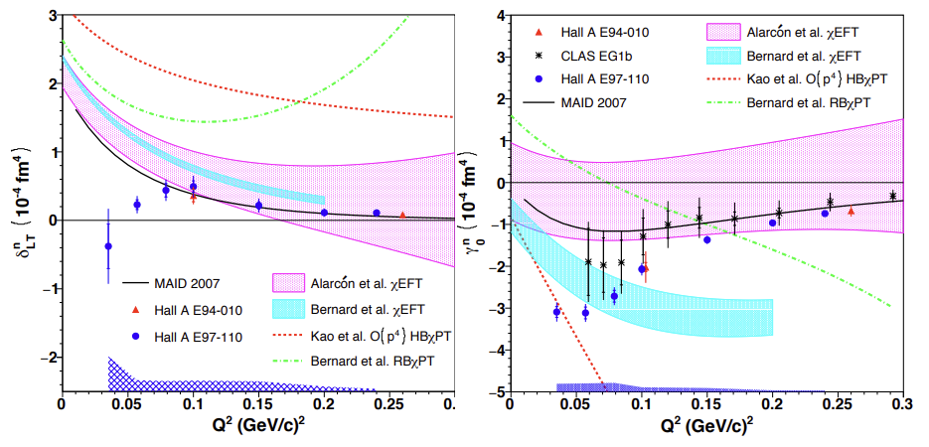
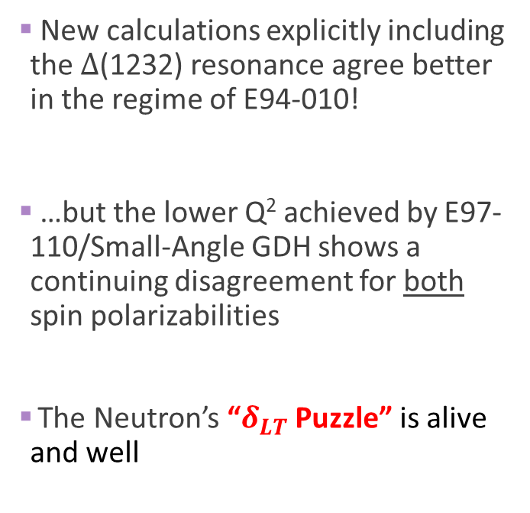
Small-Angle GDH Polarizabilities
V. Sulkosky et al., Nature Physics, Vol. 17 687-692 (2021)
New calculations explicitly including the $Δ$(1232) resonance agree better in the regime of E94-010!
…but the lower Q² achieved by E97-110/Small-Angle GDH shows a continuing disagreement for both spin polarizabilities
The Neutron’s “$δ_{LT}$ Puzzle” is alive and well

Slide 19
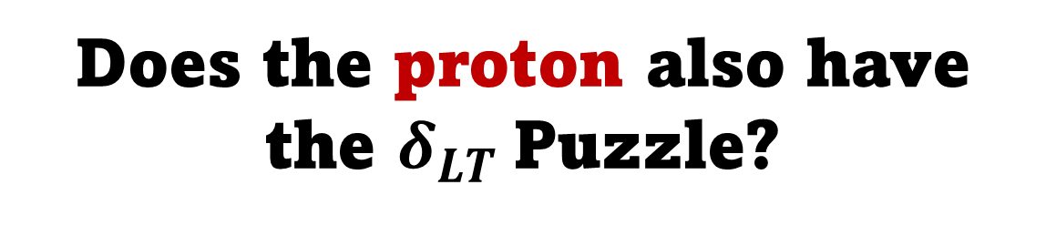
Does the proton also have the $δ_{LT}$Puzzle?

Slide 20
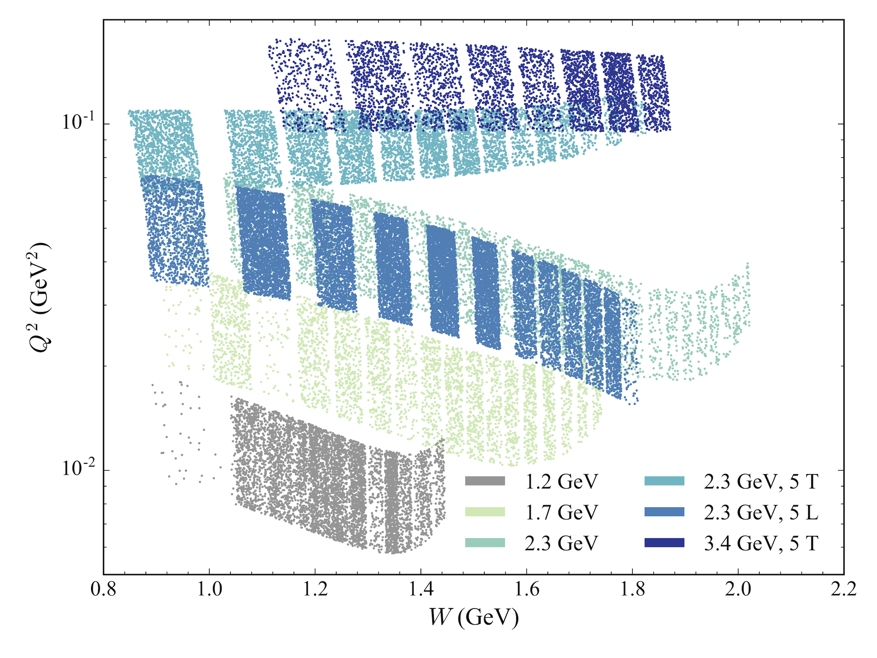
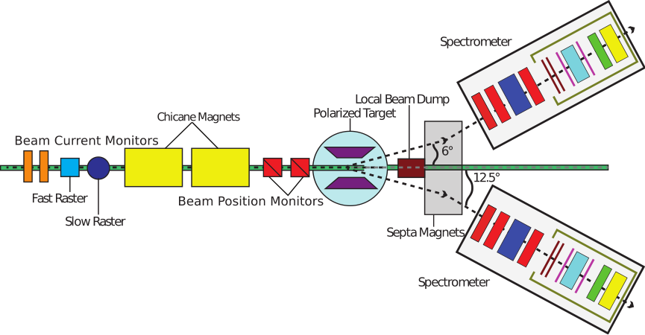
g2p Experiment
Ran in Hall A in 2012
Published results in Nature Physics in 2022
First low Q² g₂ measurement for the proton!
Transversely polarized solid NH₃ target
Septa magnets allow small scattering angle
Chicane magnets compensate for target field
bending
Covers Q² of
0.01-0.12
GeV²

Slide 21
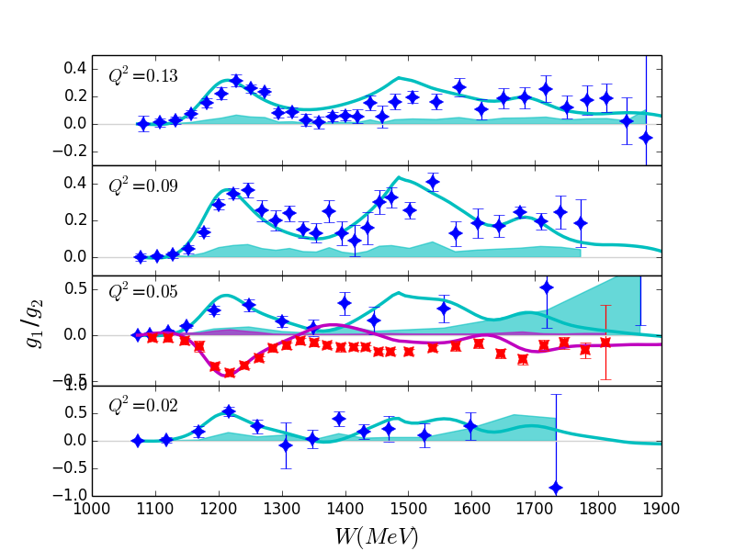
g2p Results (SSF)
g₂ results have good precision in the resonance region
Phenomenological models (Hall B, MAID) agree well with the data over most of the measured range
The experiment’s one g₁ setting has excellent precision and has data down to the pion production threshold
g₁ result stays negative while models expect a small positive result near threshold, but data is compatible with a positive result within error bars
g₁
g₂

Slide 22
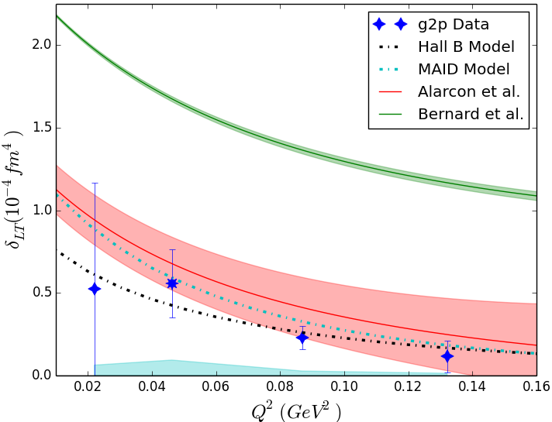
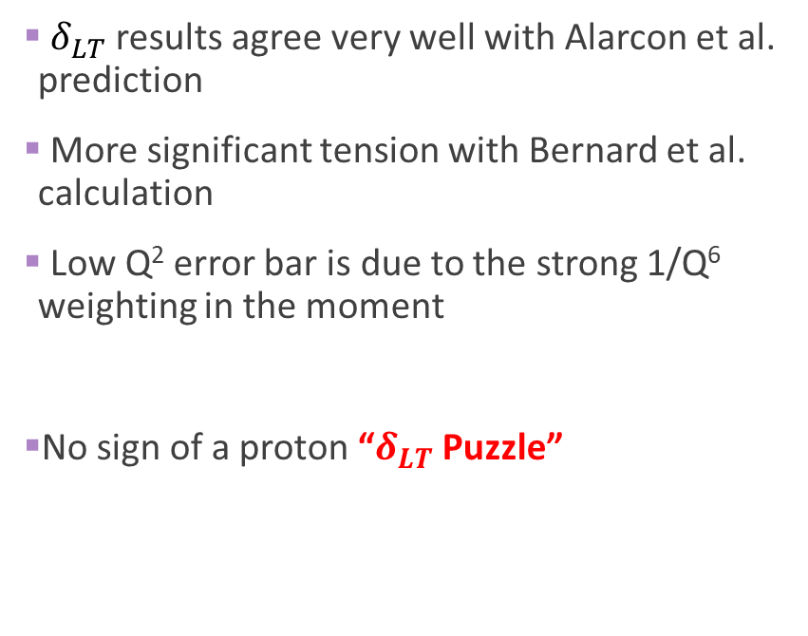
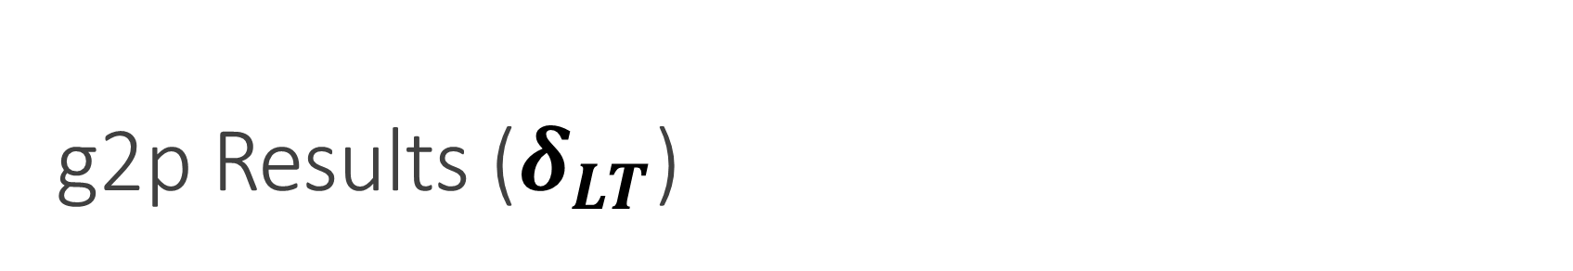
g2p Results ($δ_{LT}$)
$δ_{LT}$ results agree very well with Alarcon et al. prediction
More significant tension with Bernard et al. calculation
Low Q² error bar is due to the strong 1/Q⁶ weighting in the moment
No sign of a proton “$δ_{LT}$ Puzzle”

Slide 23
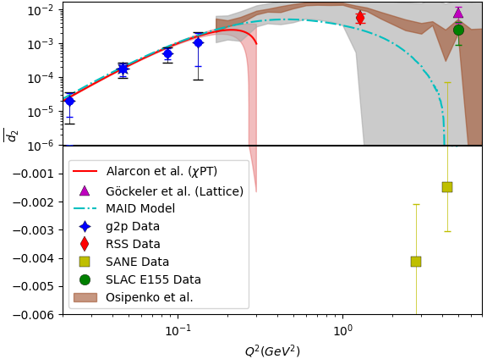

g2p Results ($\overline{d_{2}}$)
Agrees very well with Alarcon et al. prediction and phenomenological models
At low Q², the color definition drops out and this is a “pure polarizability”
Fully positive, in contrast to the negative SANE result at higher Q²
Ideal observable to try and understand the full Q² spectrum from the EFT regime to the pQCD regime

Slide 24
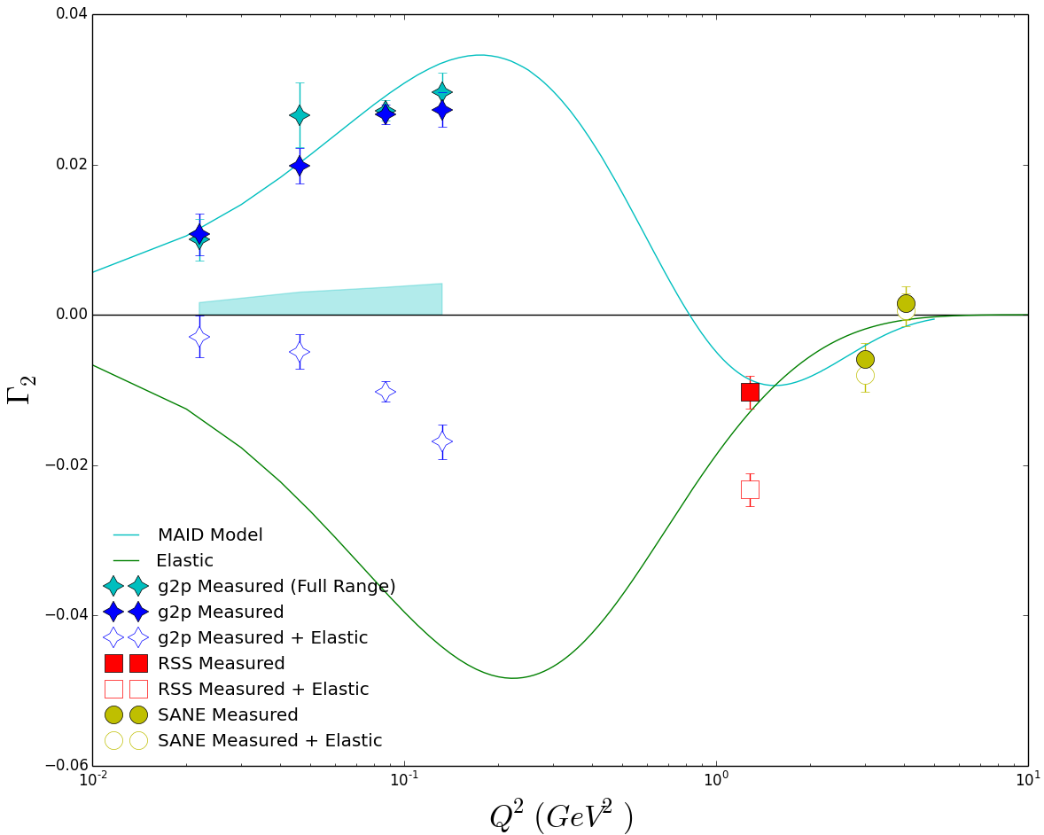
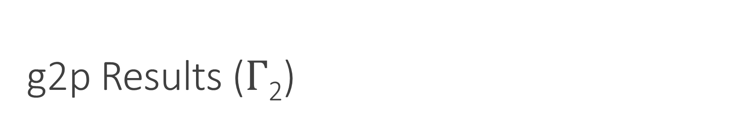
g2p Results ($Γ$₂)
Without the full integral, we can’t check B.C. Sum Rule fulfillment…
Higher Q² experiments have used g₂^{WW} to estimate this part, but because it relies on the assumption of Twist-2, it fails by this Q²
Instead, the data can be used to access the unmeasurable low-x regime if B.C. Sum Rule is assumed

Slide 25
g2p Results ($Γ$₂)
Without the full integral, we can’t check B.C. Sum Rule fulfillment…
Higher Q² experiments have used g₂^{WW} to estimate this part, but because it relies on the assumption of Twist-2, it fails by this Q²
Instead, the data can be used to access the unmeasurable low-x regime if B.C. Sum Rule is assumed
Low-x
Part of
Integral

Slide 26
We also need proton g₁ results at this same Q²…

Slide 27
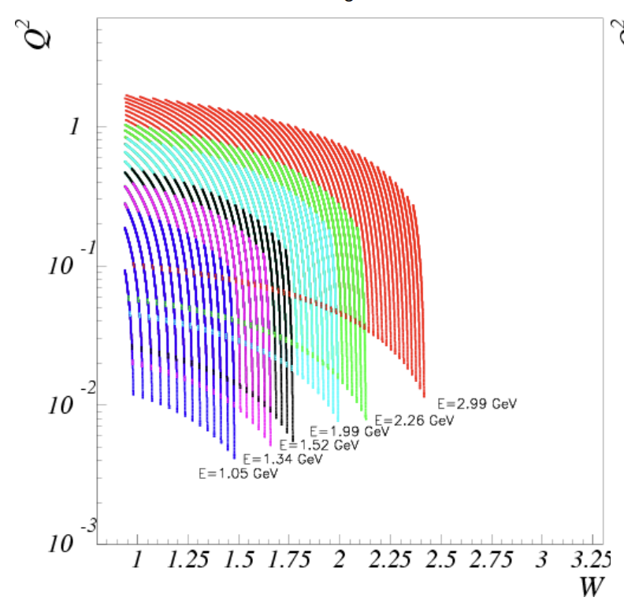
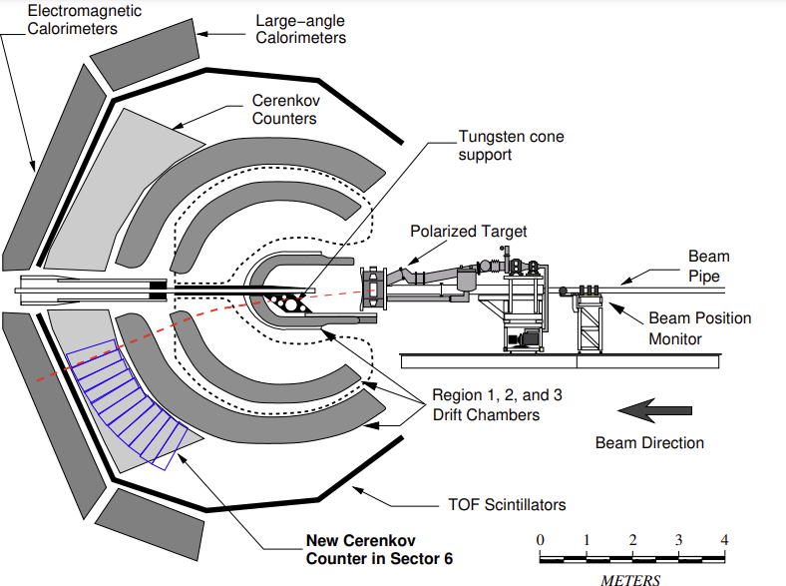
EG4 Experiment
Builds on EG1 by going to very low Q² = 0.01 GeV²
Ran with CLAS Detector in Hall B in 2006
Longitudinally polarized NH₃ and ND₃ target
Specialized Cerenkov detector improved efficiency at forward angles, allowing access to lower Q²
Excellent precision longitudinal results for both the proton and neutron
Proton results published in Nature Physics in 2021
Courtesy X. Zheng
X. Zheng, March 2009, Spin Structure at Long Distance

Slide 28
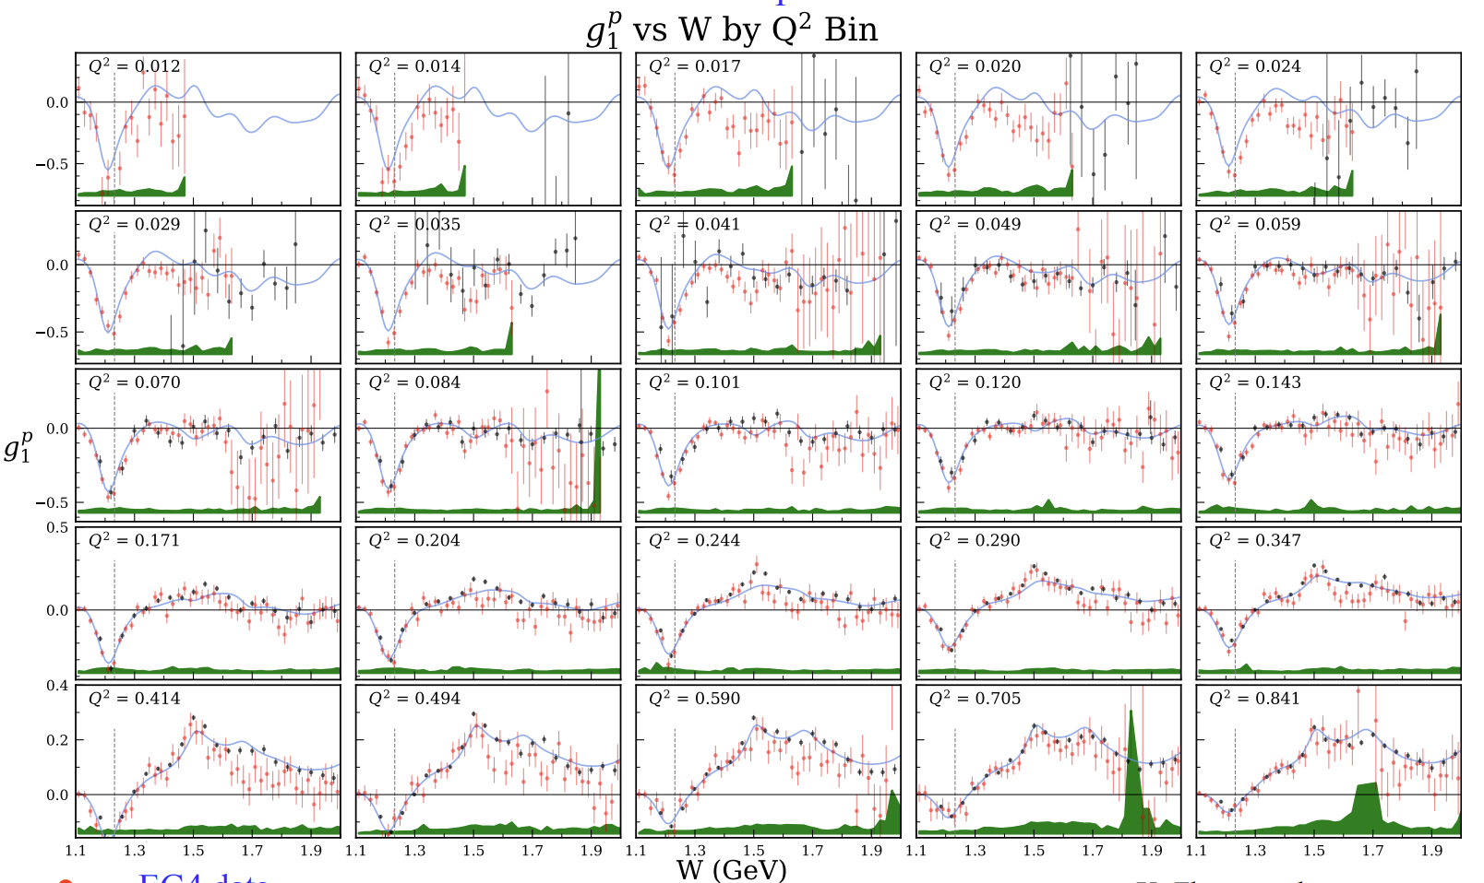
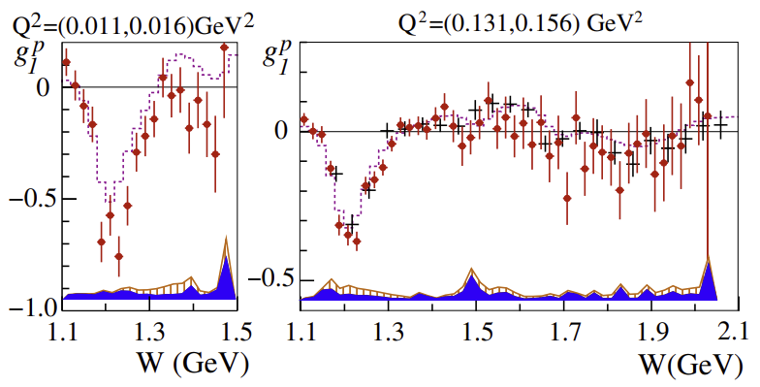
EG4 Results (SSF)
A. Deur Hadron24, Dalian, China, 08/07/2024

Slide 29
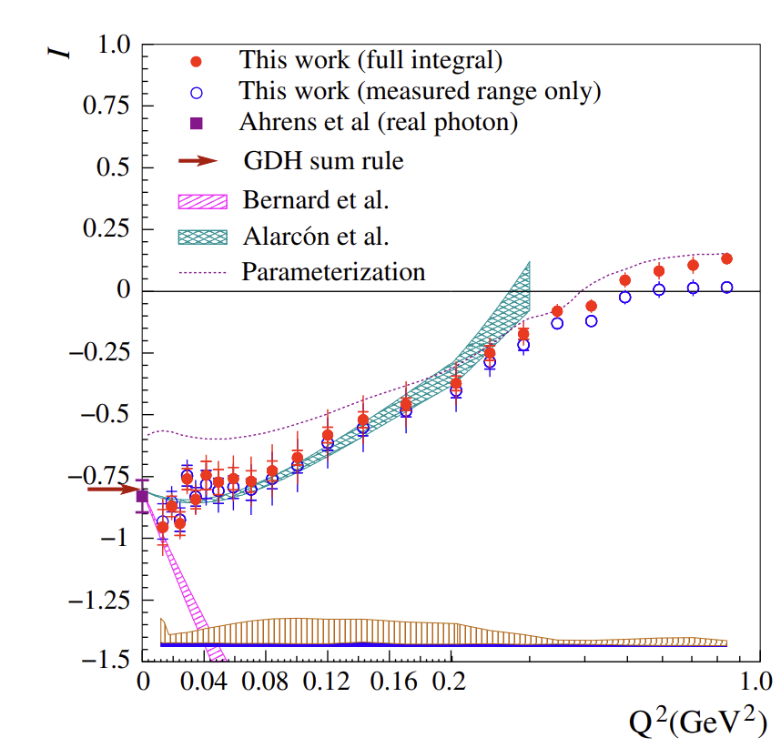
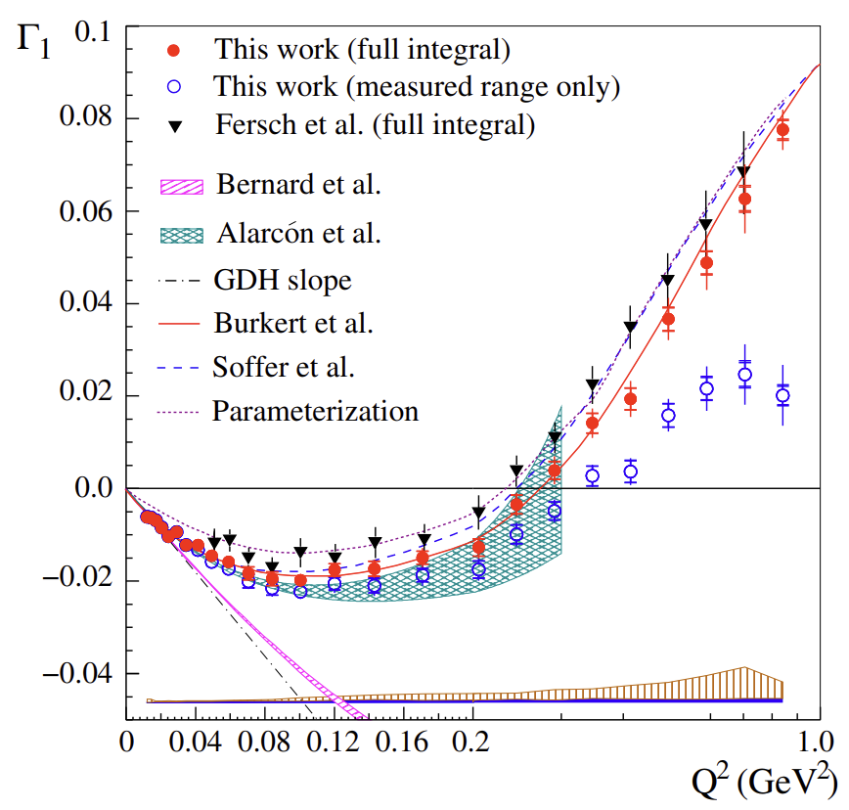
EG4 Results (GDH Sum) [Proton]
X. Zheng et al., Nature Physics 17, 736–741 (2021)
Agrees well with Alarcon et al. prediction
Better agreement with Bernard et al. calculation at lowest Q²
Seems to converge to the GDH Slope by the lowest Q² of the data
Extrapolation to Q² = 0 gives
I(0) = −0.798 ± 0.042
compared to
I^{GDH} = -0.804

Slide 30
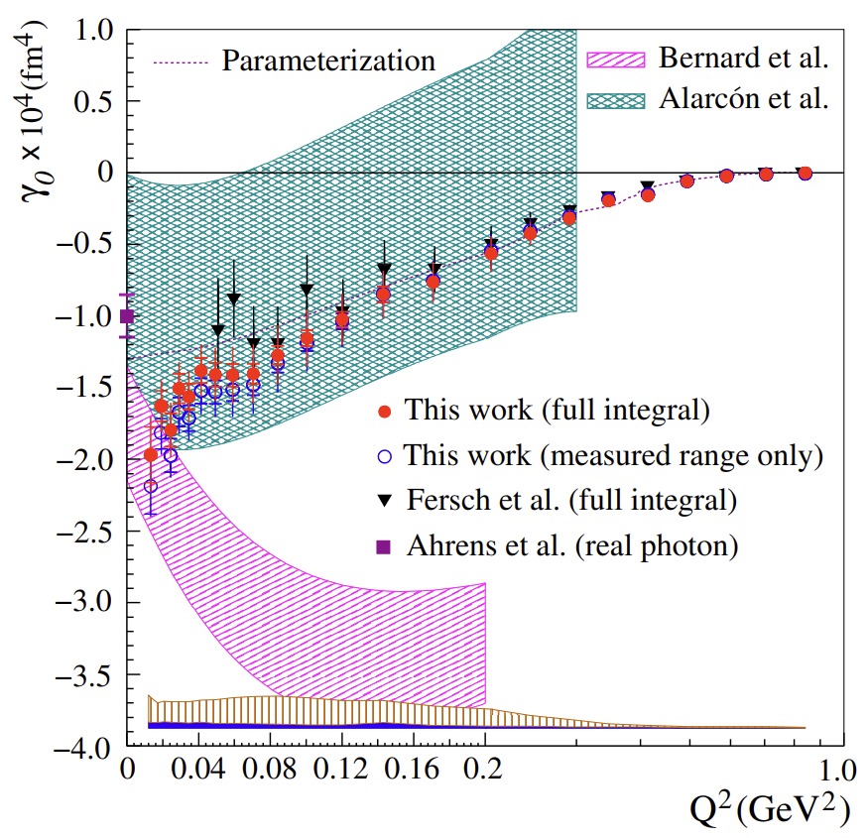
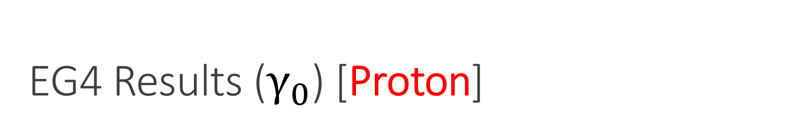
EG4 Results ($γ_{0}$) [Proton]
X. Zheng et al., Nature Physics 17, 736–741 (2021)
Most of the range agrees well with Alarcon et al. prediction
Lowest Q² point better agrees with Bernard et al. calculation

Slide 31
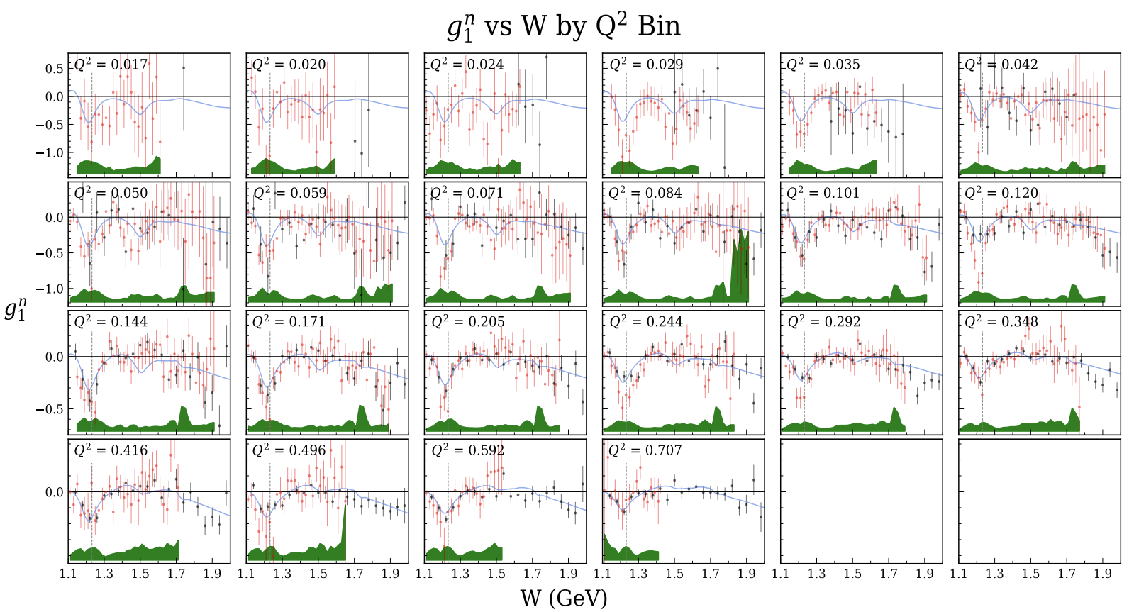
EG4 Results [Neutron]
Neutron results are still preliminary
Courtesy Darren Upton
Will be posted on Arxiv soon!
Preliminary
A. Deur Hadron24, Dalian, China, 08/07/2024

Slide 32
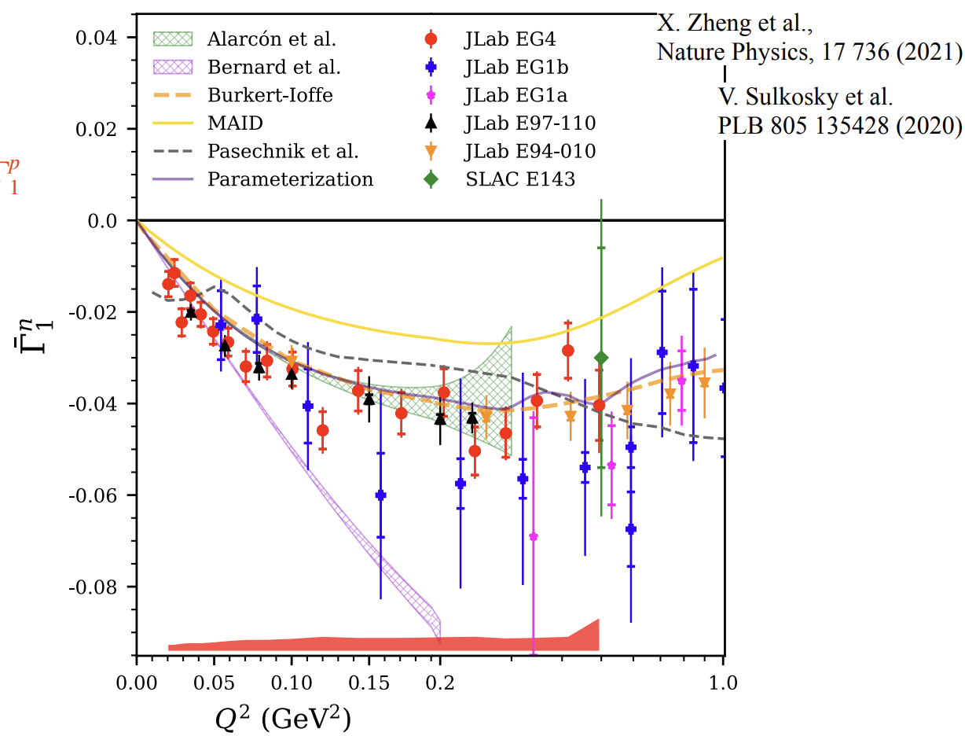
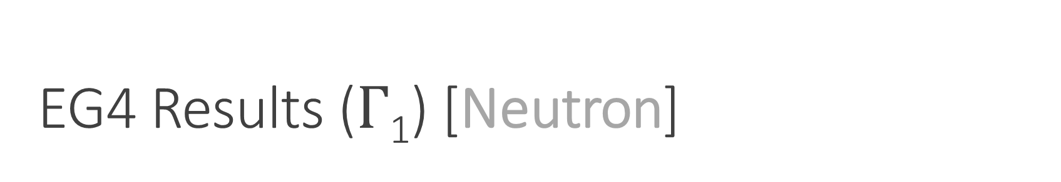
EG4 Results ($Γ$₁) [Neutron]
A. Deur Hadron24, Dalian, China, 08/07/2024
Courtesy D. Upton
Good agreement with E97-110
Decent agreement with both Bernard and Alarcon calculations at low Q², favors Alarcon calculation at higher Q²
Preliminary

Slide 33
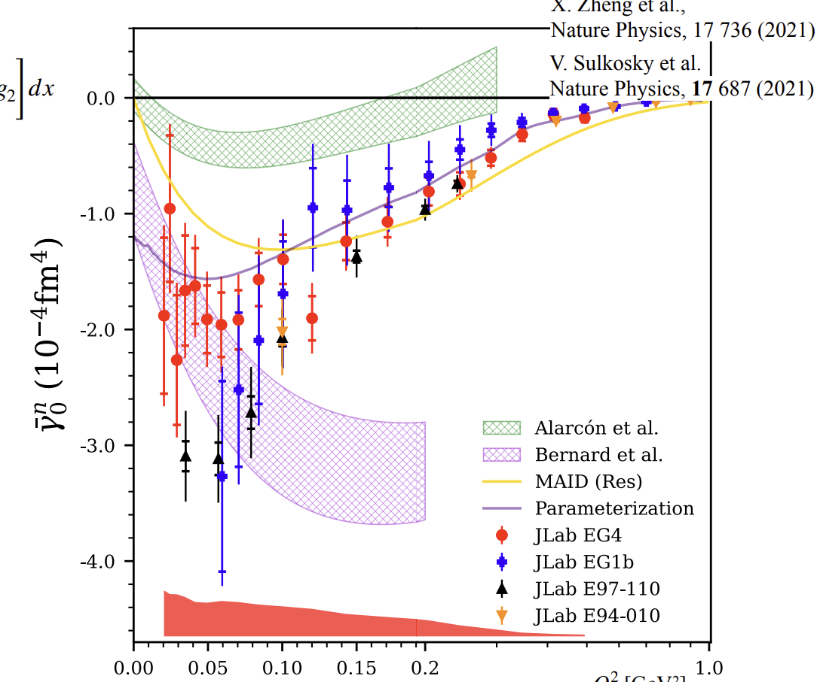
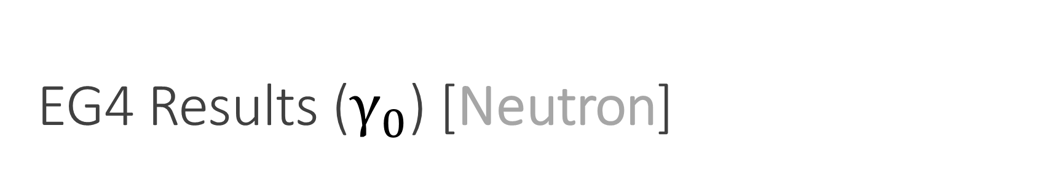
EG4 Results ($γ_{0}$) [Neutron]
A. Deur Hadron24, Dalian, China, 08/07/2024
Courtesy D. Upton
Preliminary
At high Q², only agrees with EG1b (when considering systematics)
At low Q², agrees with Bernard et al. calculation, and disagrees with E97-110 and Alarcon et al. calculation

Slide 34

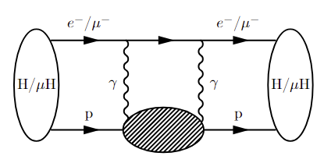
g2p / EG4 Hydrogen Hyperfine Splitting
Hydrogen Hyperfine Splitting – one of the best-measured quantities in physics
Theoretical uncertainty is a million times larger…. ☹
Upcoming searches at PSI and FAMU will need precise guidance where to look for the HFS in Muonic Hydrogen!
Two-Photon Exchange effect dominates HFS uncertainty
Polarizability effect dominates TPE contribution uncertainty = need g₁ and g₂

Slide 35


g2p / EG4 Hydrogen Hyperfine Splitting
Use Hall B model for the unmeasured low-x and high Q² parts
Fit the data to extrapolate to Q² = 0
New result cuts the data-driven uncertainty in half
Reduces longstanding tension with 𝛘PT dramatically!
But, still some clear tension remains…

Slide 36



HFS Analysis – Zemach Radius
Courtesy F. Hagelstein
Using highly precise HFS measurement we can use our $Δ_{pol}$ to get R_{Z}:
Compatible with FF results and Lattice QCD prediction
Thanks to HFS Analysis collaborators:
F. Hagelstein, V. Pascalutsa, C. Carlson
A. Deur, S. Kuhn, X. Zheng, M. Ripani
K. Slifer, J.P. Chen

Slide 37



Transition Region g₂p Proposal
PR12-24-002 Projected Uncertainties
Experiment to measure proton g₂ from 0.22-2.2 GeV² proposed to PAC52 in July 2024
Will fill a major gap in g₂ spectrum, bridging the effective theory regime with the perturbative QCD regime
Conditionally Approved (C2) by PAC52!

Slide 38




Recent Publications
E97-110 Neutron Results (g₁ and g₂):
Sulkosky et al. Nature Physics. volume 17, pages687–692 (2021)
EG4 Proton Results (g₁):
Zheng et al. Nature Physics. volume 17, pages736-741 (2021)
g2p Proton Results (g₂):
Ruth et al. Nature Physics. volume 18, pages1441–1446 (2022)
g2p+EG4 Hyperfine Splitting Results:
Under Review at Physics Letters B…
arXiv:2406.18738

Slide 39

State of Comparisons to 𝛘PT
𝛘PT reproduces the data well sometimes and not as well other times
Still some question on how the two cutting edge 𝛘PT calculations compare to each other
Hydrogen HFS: Diminished but still significant tension between data and 𝛘PT
$δ_{LT}$: No sign of “$δ_{LT} P$uzzle” for proton, but the puzzle remains at the lowest Q² neutron data
$d_{2}$: No tension for proton
$Γ_{1}/GDH:$ Good agreement for proton, some tension for neutron
$γ_{0}:$ Good agreement for proton, some tension for neutron

Slide 40
Conclusion
𝛘PT is doing a much better job with the proton than the neutron, though questions still remain about the proton, especially the HFS
Lattice QCD can also produce many of these quantities – this data provides a benchmark to check these calculations when they are finished
Lots of recently published high precision spin structure function and moment data out of JLab, with more on the way
SSF moments and polarizabilities provide a crucial benchmark for testing low Q² effective theories!
Thanks!

